Slide 1
Covid 19 fight and public health.

Slide 2
Who we are

Slide 3
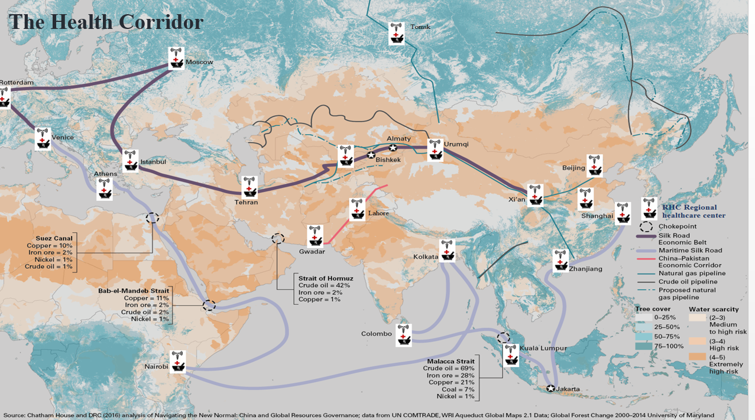
Fight for Covid 19

Slide 4
We published first time in the world Covid 19 treatment protocol and published from China.

Slide 5
Background
Covid 19 a global issue which need to specific focused area work in different region.
These days many countries already succeeded maximum no of people vaccination. But there is no joint investigation done for Covid related medical data sharing including post covid related health issue.
Any pandemic situation need joint effort by many countries. But Covid 19 issue we face many difficulties for joint effort by many countries.
World health organization did small clinical trial via email with 749 patient for post covid syndrome.
We strongly believed with our strong network in belt and road countries we can do minimum 10 countries with 30 hospital, 10000 post covid patient closed clinical survey to understand the reason and make a common prevention method and make guideline for future journey.

Slide 6
Specific problems:
Our team did research and find 2 main common problem related with Post covid related disease.
1. Post Covid Lung related Disorder and breathing difficulties.
2. Post Covid heart related disease.
Example: Myocarditis
Above those 2 diseases are main problem we are facing globally .
Many post covid patient even cant recognized by doctor . globally its huge burden for society.

Slide 7
Solution
Its need proper join planning for research, clinical trial, long time prevention planning and sharing information with every one.
China already proved they did more than any country in the world for protecting virus for whole world.
Chinese doctors went to many countries for sharing the treatment idea and help many doctors sharing their real time experience. Its right time to make some proper planning POST COVID SYNDROME management for reducing public health hazards .
we can design international health monitoring system and data exchange.
Country list who agreed to join with us-
Bangladesh, Nepal, Pakistan, Indonesia, Egypt, Thailand, Saudi arabia. Dubai, Nigeria, Cambodia.
We don’t take any patient data from those countries, we only take the data analysis report prepared by doctor team.
- We already prepared the patient clinical data set which we will use for clinical trial time.
-our expected patient enrollment In our project is 10000 patient.

Slide 8
Our Vision
Reduce Covid 19 related Diseases burden in Belt and Road Countries
Establish Technology exchange with modern treatment for post covid Disease
Academic Exchange
Young Doctors training
Increase Covid 19 related health facilities in Belt and Road Countries
Sharing Telemedicine service
Common covid 19 clinical Data cloud system for Belt and Road Countries hospital.

Slide 9
Total 30 hospital will join in this project from 10 belt and road countries
30 Hospital
10 countries
ALL will be under one Platform
This project will lead Covid 19 fight and public health related issues.

Slide 10
Action Plan
All hospital director will join In this project
Project year-2022 July to 2023 july
Doctors training, join Research program , BIG Data bank ,AI for Covid 19 health hazards
prepare own mobile APP for project
Collect patient data and evaluate to understand health hazards

Slide 11
Our proposed APP Logo
This APP can help for Data Entry
Automatic data analysis
Internal communication with doctors
Doctors training video sharing option available in this APP

Slide 12
Sharing of Goals & planning the strategy
Core Member :
Approval of strategy
Executive Committee:
Transfer of goals to healthcare staff
Action plans:
Task Force Implementation

Slide 13
Join Cooperation
The Belt and Road Initiative also provides a common platform to improve the capability of handling regional public health emergencies through epidemic information sharing
Reducing covid 19 heath related burden our main Goal
We will learn from each other
China has committed to provide medical assistance e and emergency medical support to Belt and Road partners

Slide 14
Our Project outcome
Advanced public health awareness
Prevention for future post Covid 19 related diseases.
Using big data science for health
Maintain stable communication with other country for covid 19 issues.
prevent future covid 19 related public health hazards
sharing latest technology with other countries
Maintain global health.

Slide 15
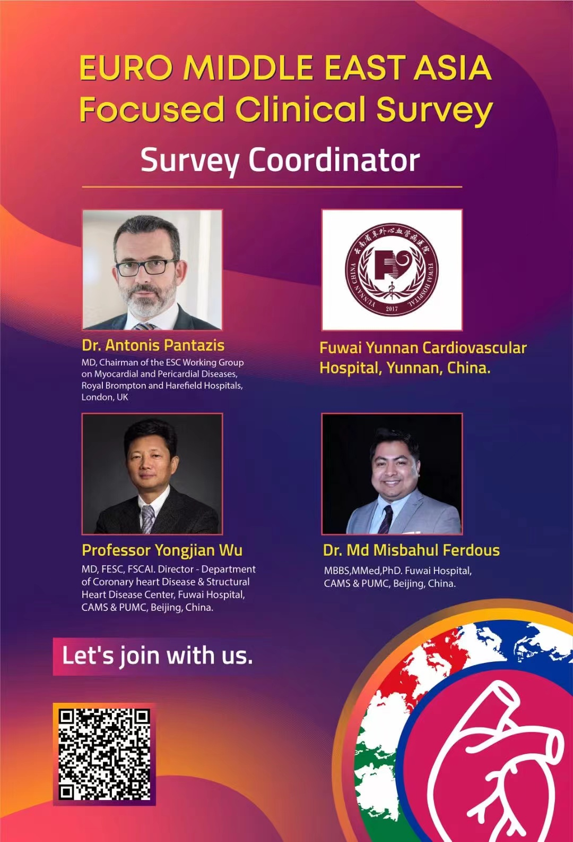
we already did big clinical trial

Slide 16
Thank You
Thank you

