Slide 1
Proposal theme
Open China in foreigners` eyes
June 2022
Dotsenko Anna，Huangpu International Innovation Research Institute
Mostak Ahamed Galib, Wuhan University of Technology

Slide 2
目录
CONTENTS
1
Background
2
Key details of the project
3
Videos` overview
4
Plan of work

Slide 3
1
Backgound
Tell Chinese stories well
Key concepts

Slide 4
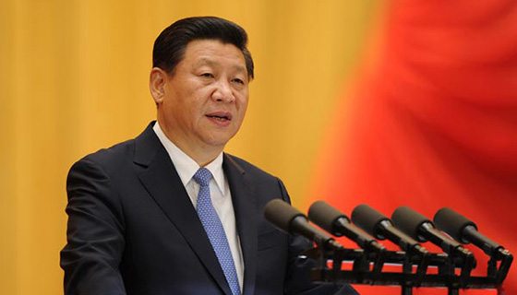
Backgound
Tell Chinese stories well
2021.05.31
2020.12.15
President Xi Jinping emphasized at the 30th collective meeting of the Political Bureau of the CPC Central Committee on strengthening my country's international communication capacity building:
Telling Chinese stories well, disseminating Chinese voices well, and showing a real, three-dimensional and comprehensive China are important tasks to strengthen my country's international communication capacity building.
The Global Young Leaders Dialogue (GYLD) program is a unique communication, education, and professional development platform for young achievers with diverse regional, cultural, disciplinary, sectorial, and professional backgrounds across the globe. GYLD builds on the world’s global young leaders’ programs and emphasizes shared values such as open and equal dialogue, intellectual exchange, inclusive and mutual learning.
"In order to strengthen comprehensive national strength, build international communication capabilities"

Slide 5
Backgound
Tell Chinese stories well - Key concepts
Make the strongest voice in China
01
Focus on innovation and development
05
02
Show the most real and beautiful picture scrolls in China
Spread leads the big trend of thought,strengthen friendship between youth of different countries
04
03
Spread and show the real China

Slide 6
2
Key details of the project
Strong witn innovation and culture
CIS countries` resources
Current work in organizations
Areas of cooperation
We are the bridge between China and “One belt, one road” countries

Slide 7
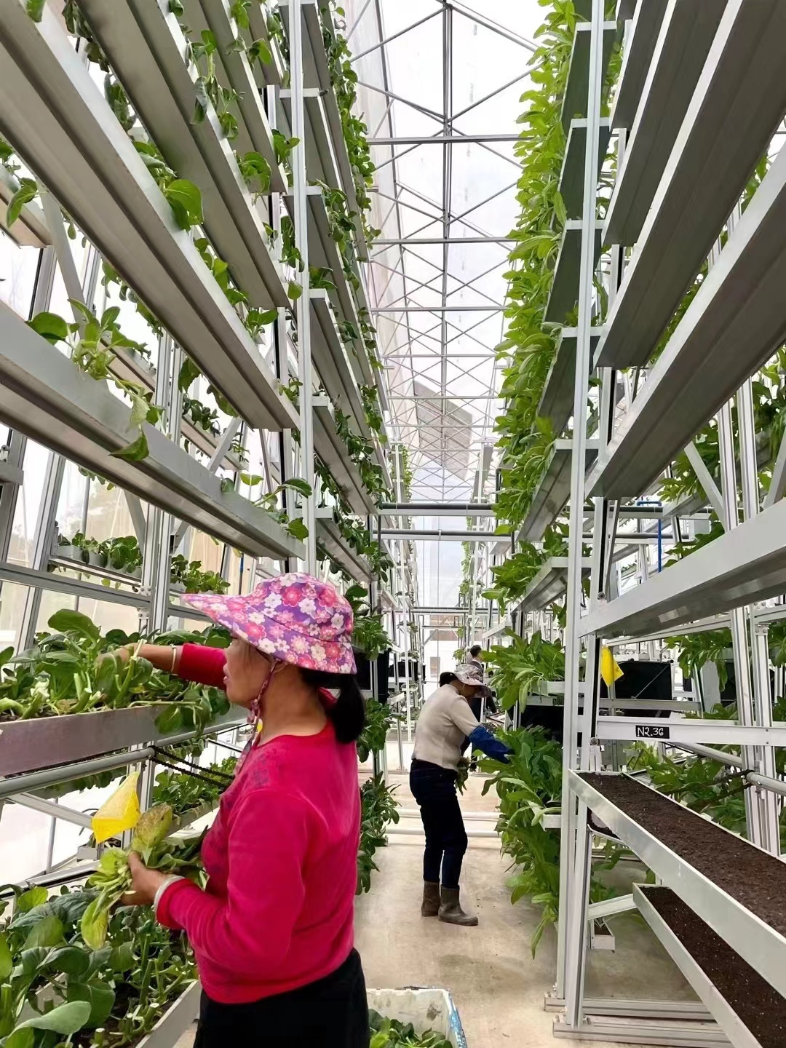
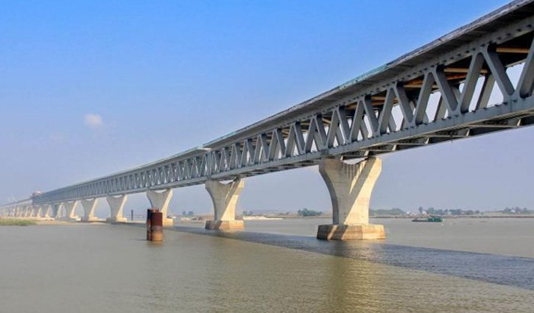
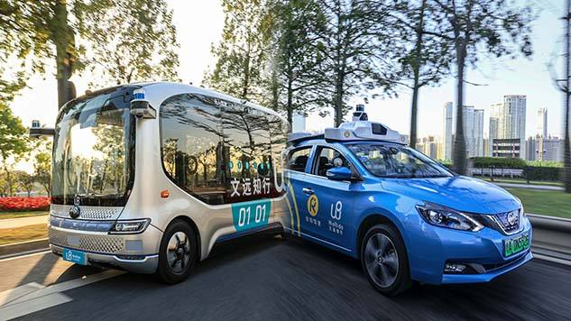
Key details of the project
Strong with innovation and culture
New technologies
Development of rural areas
Padma bridge
In order to achieve equitable development and reduce poverty in remote rural areas, priority is given to support from the state, enterprises and more affluent neighboring areas.
Artificial intelligence
New materials
Green technologies
Biomedicine
Robotechnics
Nanomaterials
The longest bridge over entire Ganges river in terms of both span and the total length.
the Padma Bridge would increase the country's GDP by 1.5 to 2 percent
Practical implementation of the concept of "creating an open, free innovative eco-environment"

Slide 8
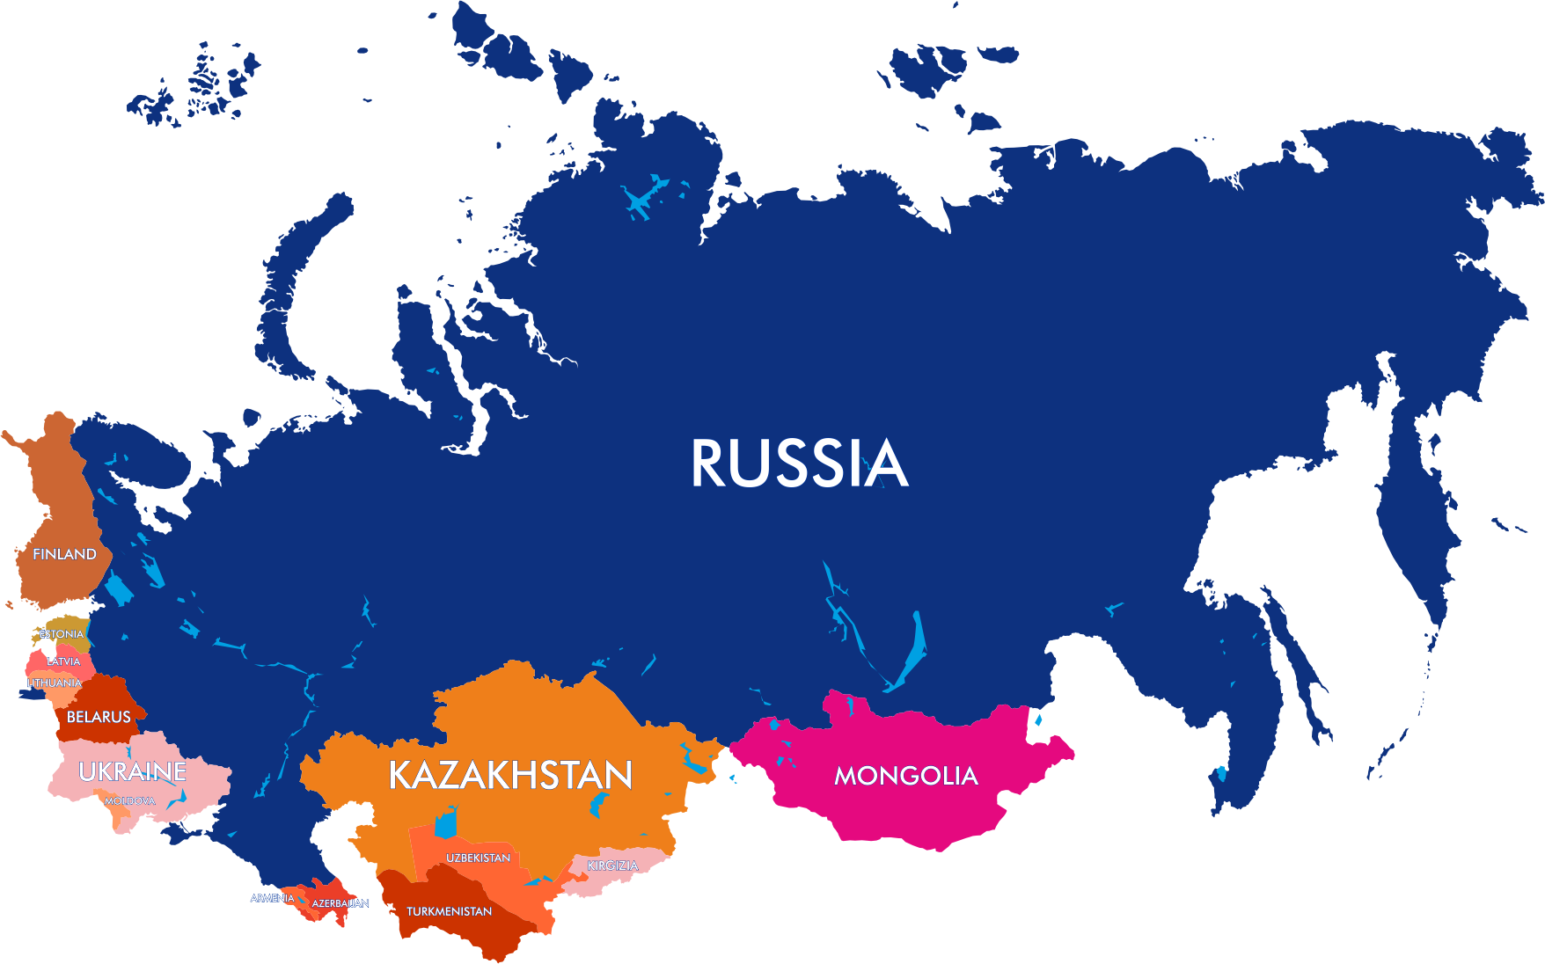
Key details of the project
CIS countries` resources
NAS of Belarus
State Center for Technology Transfer of Belarus
BNTU
BSTU
BelSUT
431 research institutes
16879 researchers
Central Bank of the Russian Academy of Sciences
FEB RAS
UB RAS
SB RAS
SFU
MSTU im. N. E. Bauman Moscow Polytechnic University
MEN NRU
National Association of Hydrogen Energy in Russia
Ros. National Laser Association
Russian Foundation for Basic Research
NTP of Russian-Chinese Friendship
4175 research institutes
738.9 thousand scientific researchers
Joint research institutions of the Eastern European countries of the CIS (partial)
Vilnius University
Lithuanian SSTP
National agency for technological development of Kazakhstan
ENU them. L.N. Gumilyov Kazakhstan
KazNAU
NAS of Georgia
GTU Georgia

Slide 9
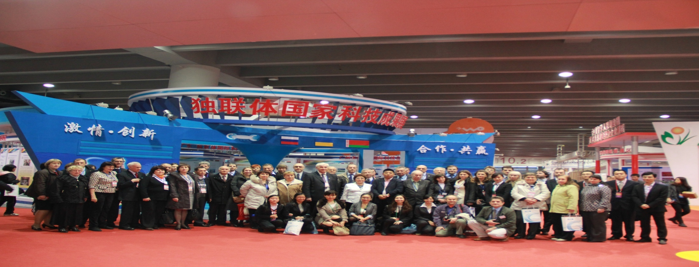
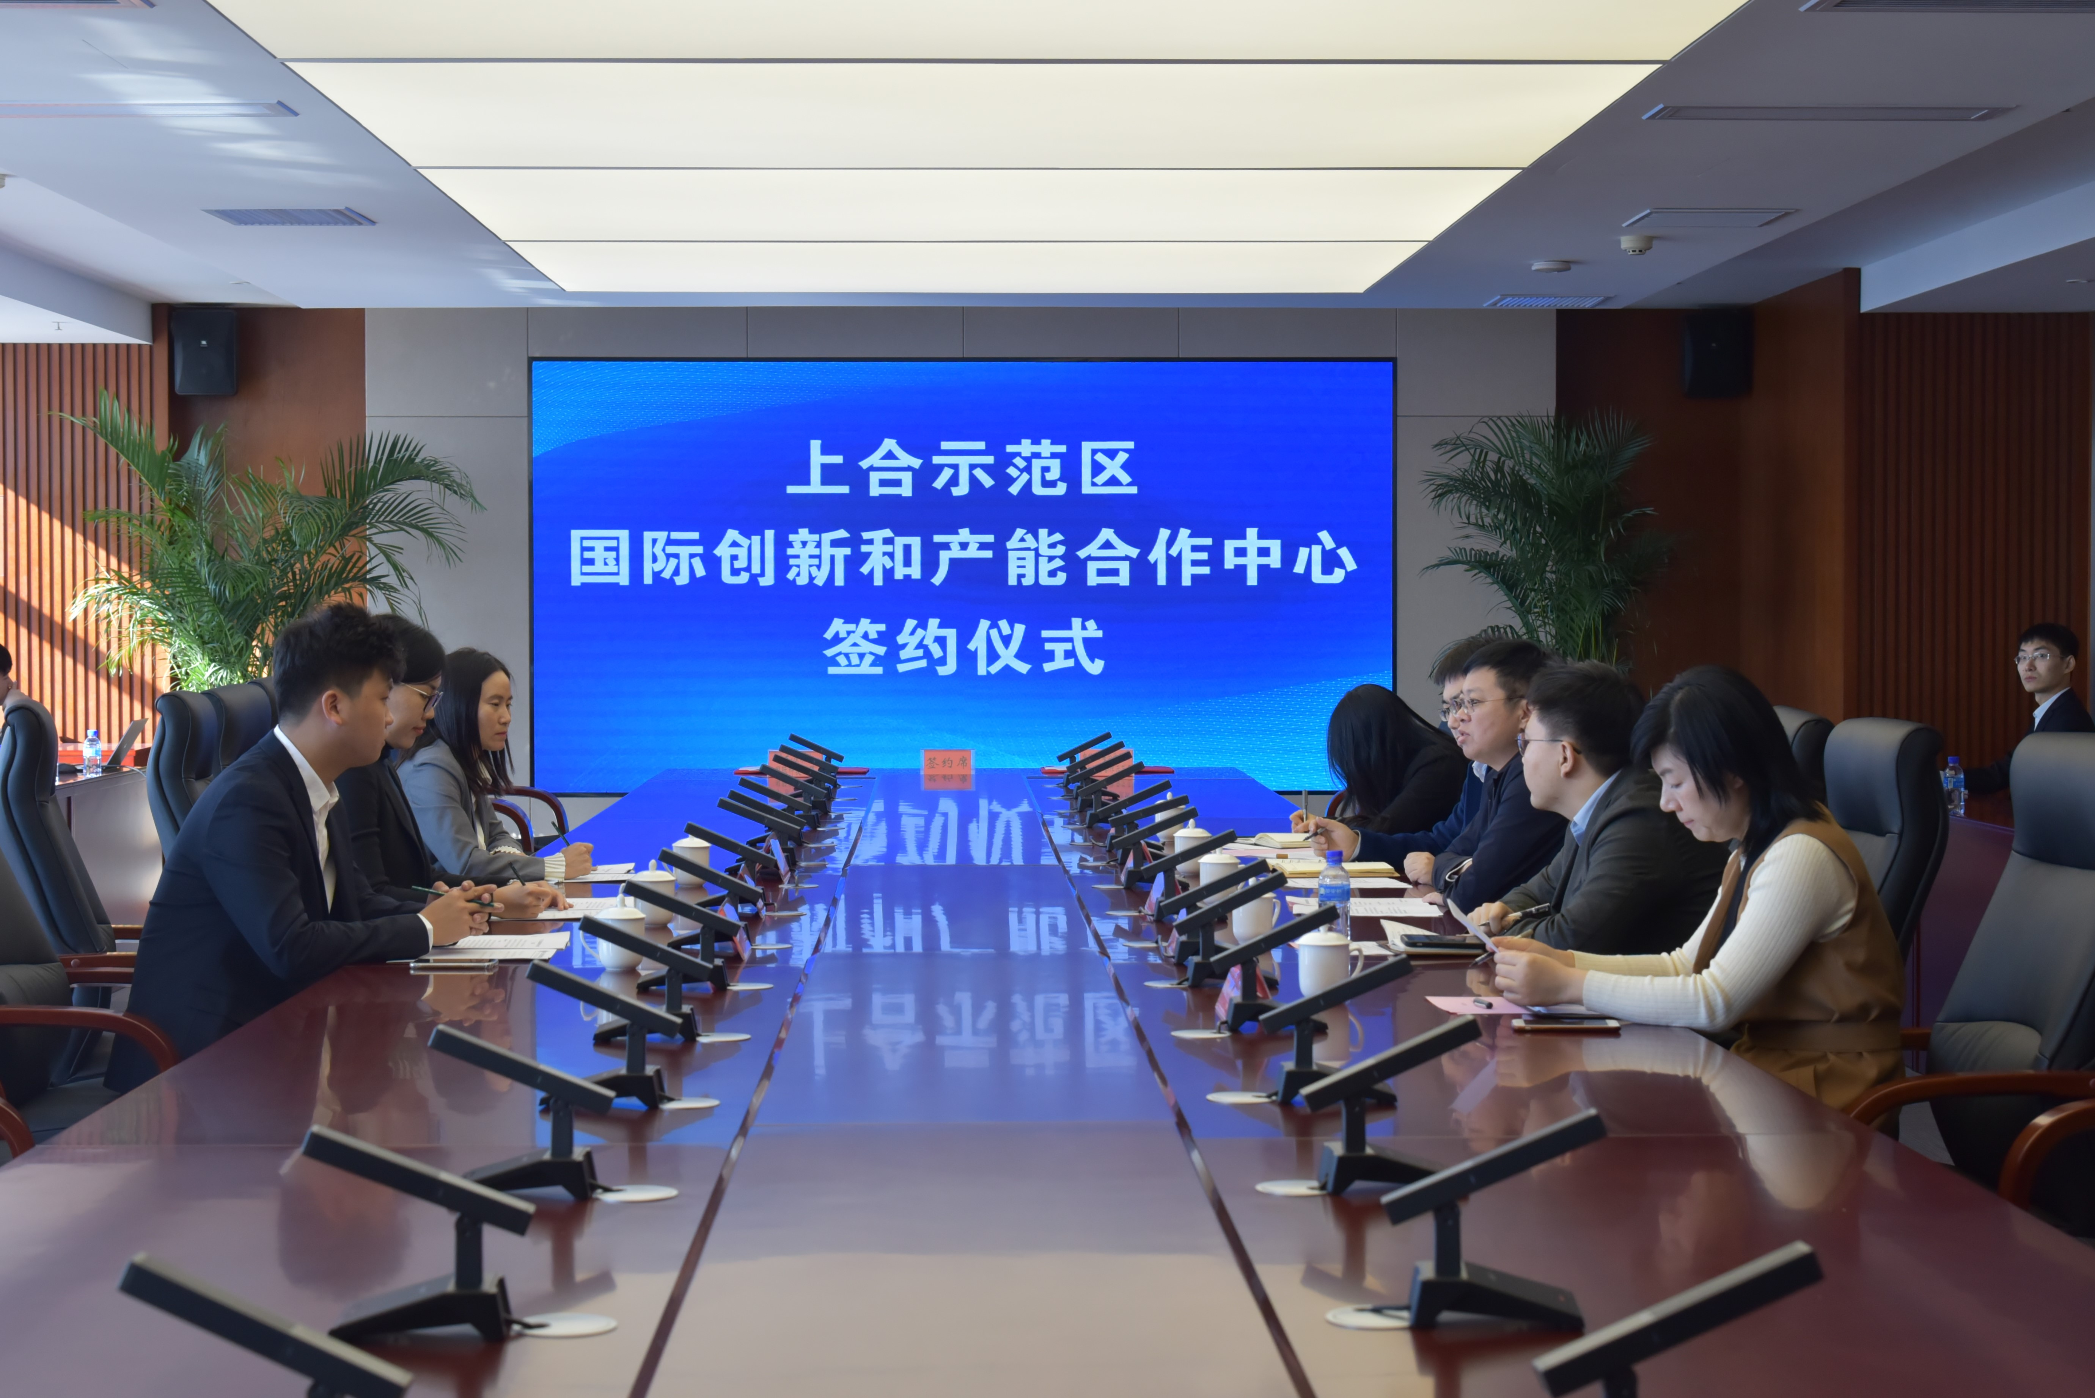
Key details of the project
Сurrent work in organizations
Guangdong-CIS International Science and
Technology Cooperation Alliance
Center for International Cooperation in the Field of Innovation and Production Capacities at the SCO Demonstration Zone
International technology transfer policy formulation and promotion
International high-end talent introduction business
Promote the implementation of major projects
"One Belt One Road" Economic and Trade Business
International Technology Incubation Business
Service platform for the integration of business, tourism and culture
International service platform for the exchange of innovative talents and their implementation
International service platform for technology transfer and project impelementation
With the support of the Ministry of Science and Technology of China and the Guangdong Provincial Government founded in 2009.11.21 in Guangzhou, Guangdong. There are 13 branches in the country and abroad. 950 technology transfer projects have been successfully implemented， 430 agreements were signed.
303 senior experts from the CIS countries have been introduced, including 23 academicians and 80 senior researchers.
With the support with the support of the administrative committee of the SCO demonstration zone the Center was founded in 2019 in Qingdao, Shandong. This center is the branch of the Guangdong-CIS Inernational Alliance.
124 projects were docked, 43 memorandums and agreements were signed between research institutes, technology parks, special economic zones and enterprises of Russia and the CIS countries

Slide 10
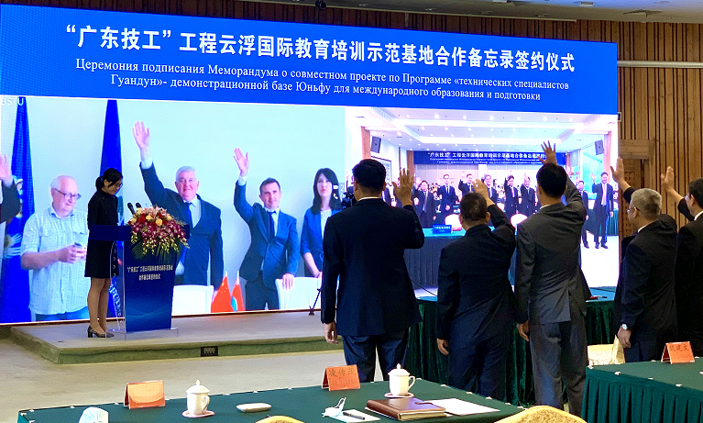
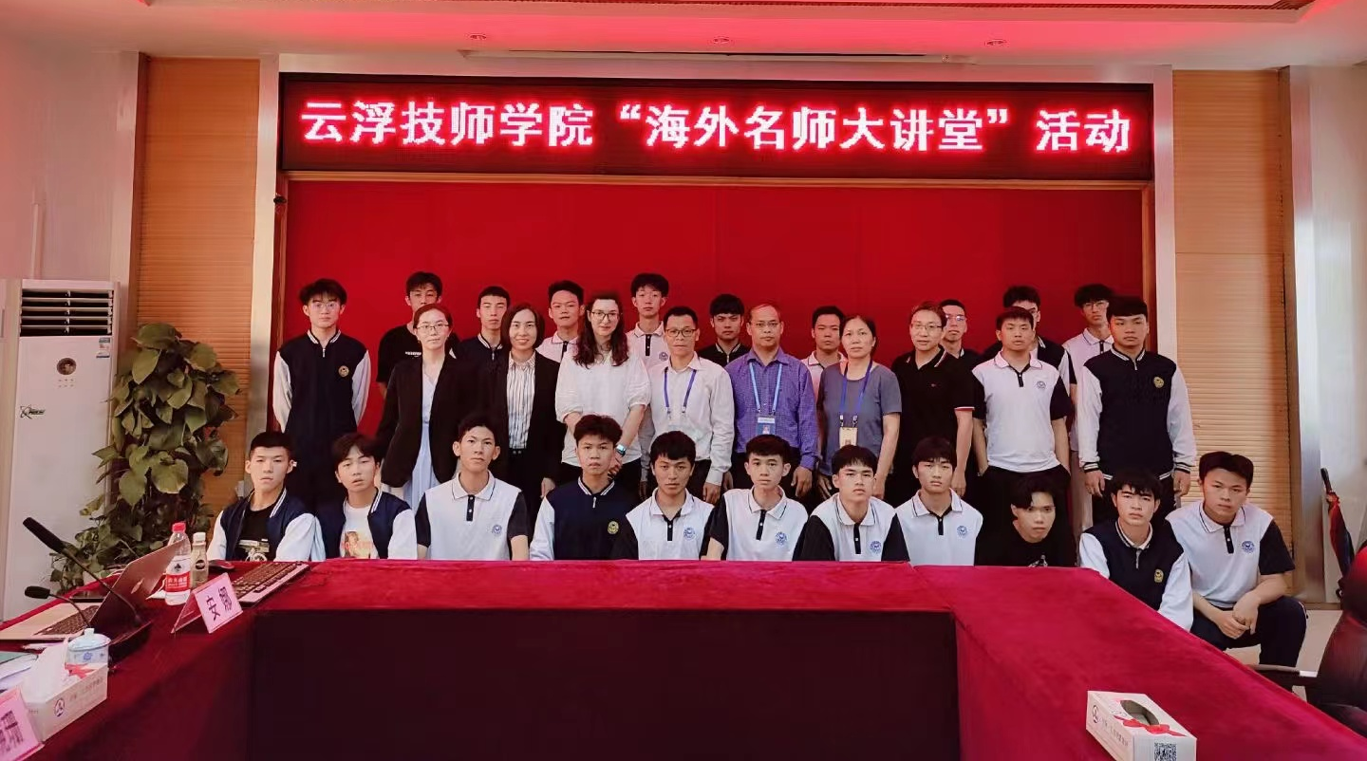
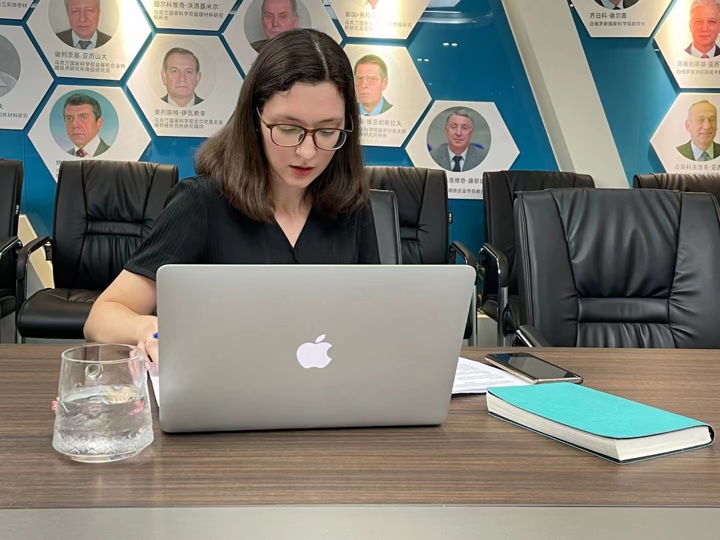
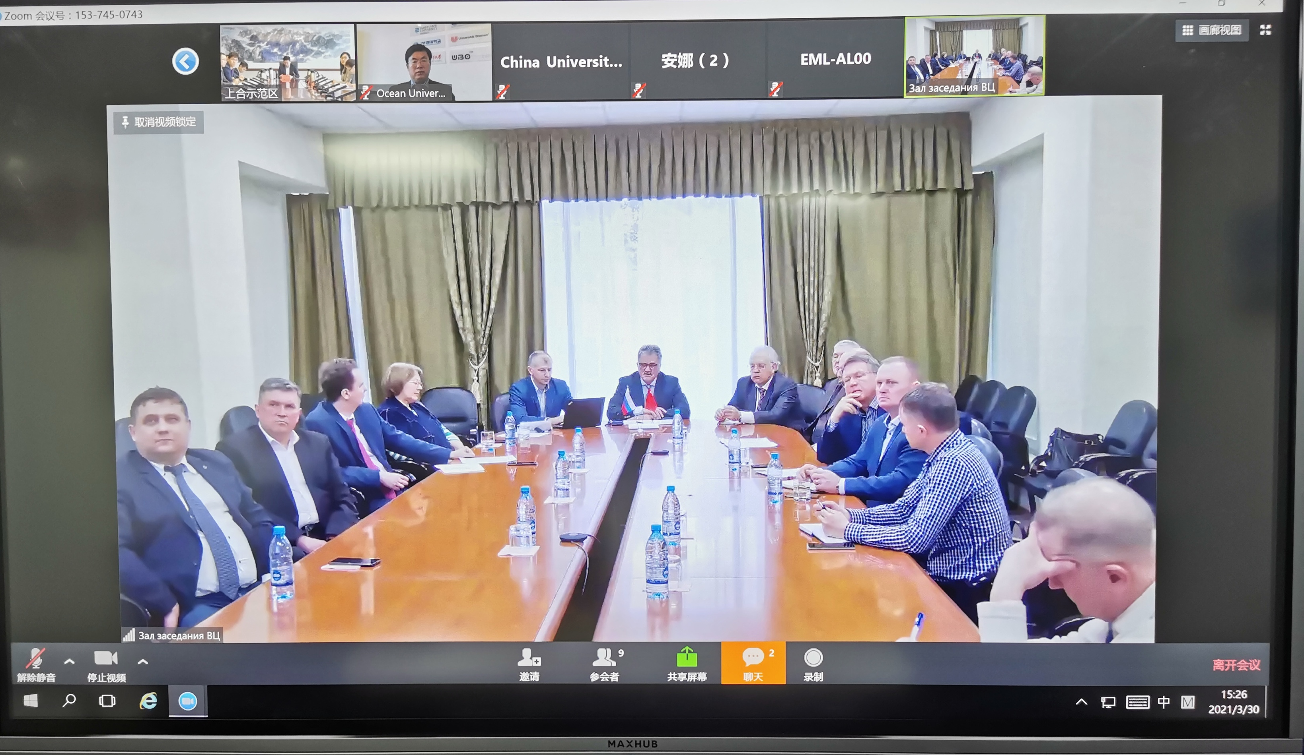
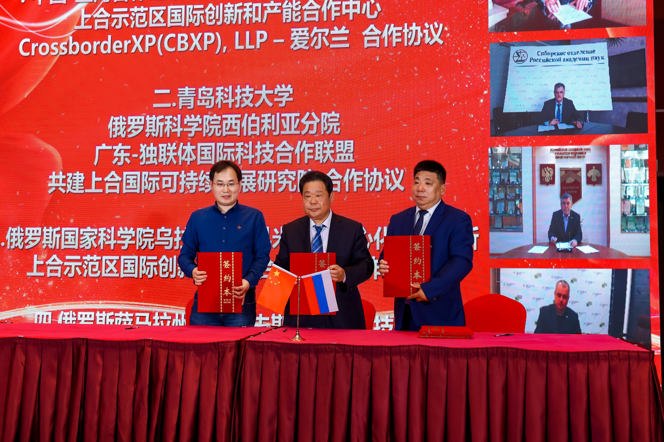
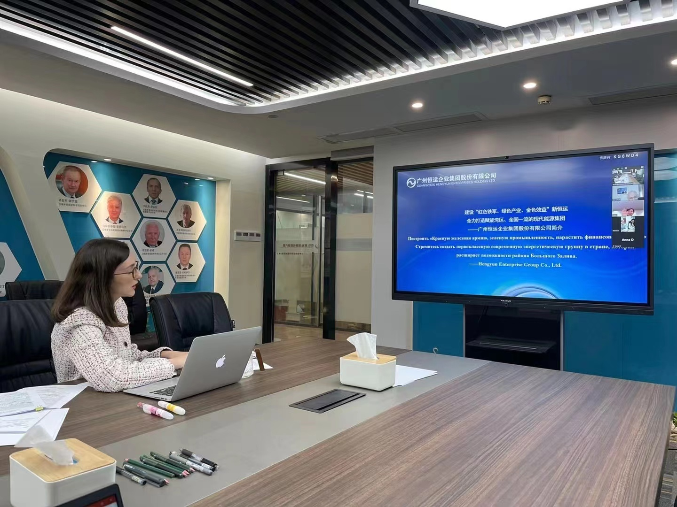
Key details of the project
Аreas of cooperation
02
Landing science and technology projects
Сonnect and develop projects with Academy of science research institutes, technology parks, innovation centers in Russia and One belt, one road countries in the field of green technologies, carbon neutrality, new materials, information technology, terahertz research, new energy sources, etc.
01
Worldwide education cooperation
In July 2020, the Alliance and Belarusian State Polytechnic University and Yunfu Technician College jointly started for the joint construction of the "Guangdong Technician" project Yunfu International Education Base， then signed the online-course of training“Worldwide top-professors”.

Slide 11
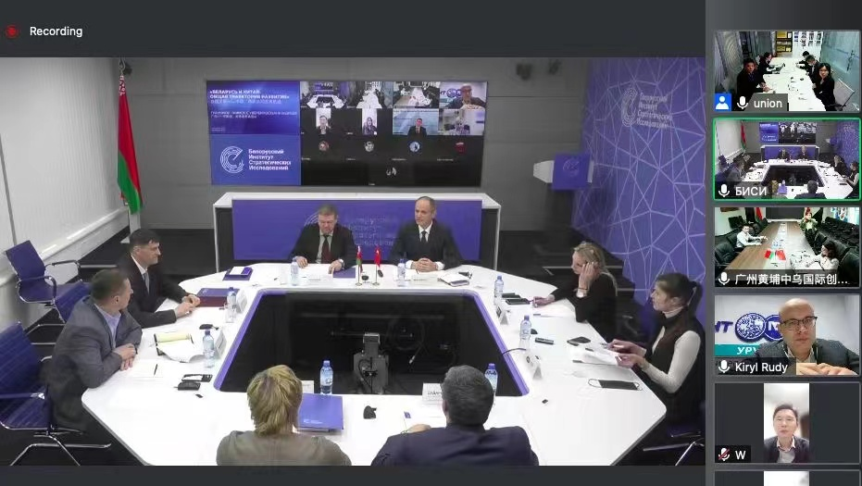
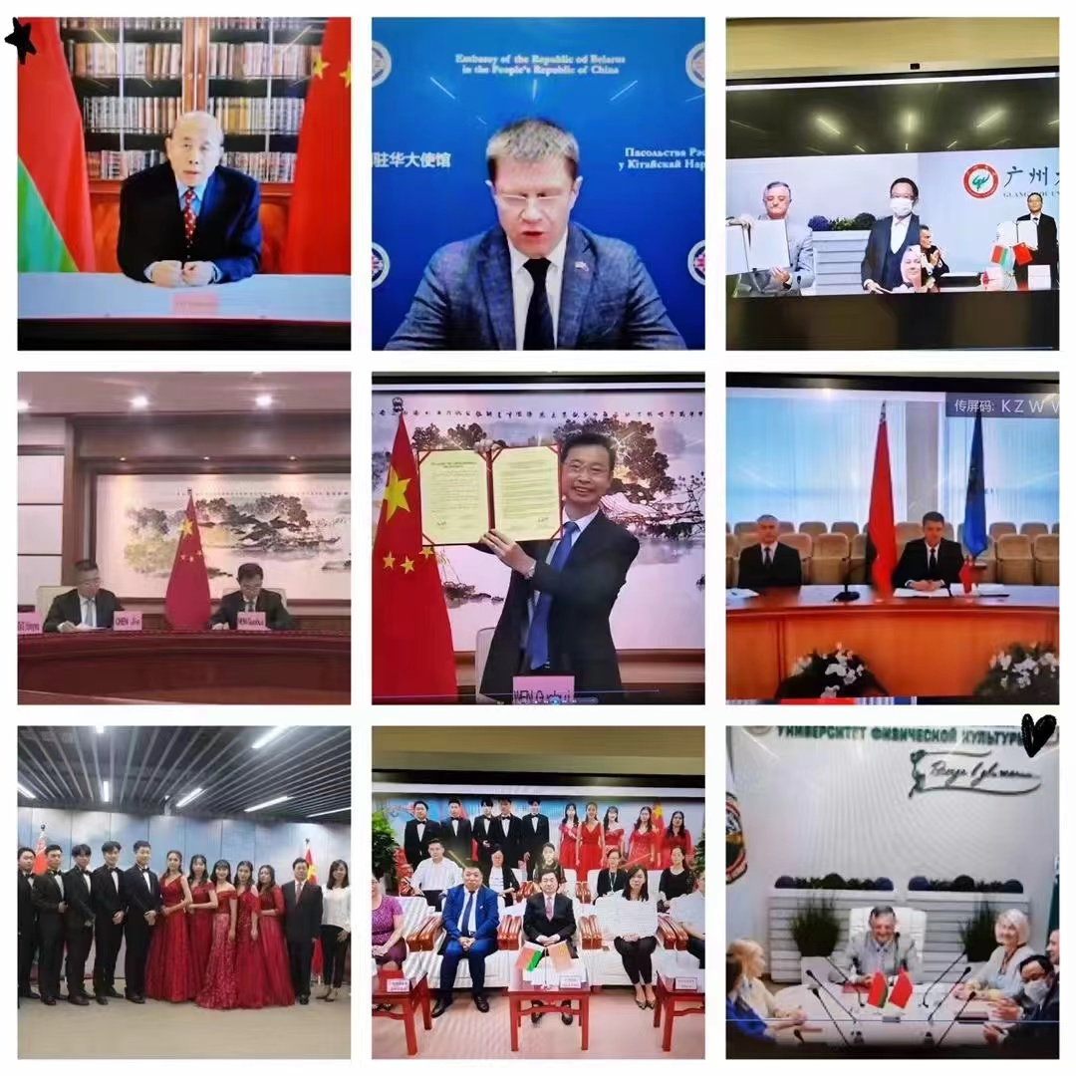
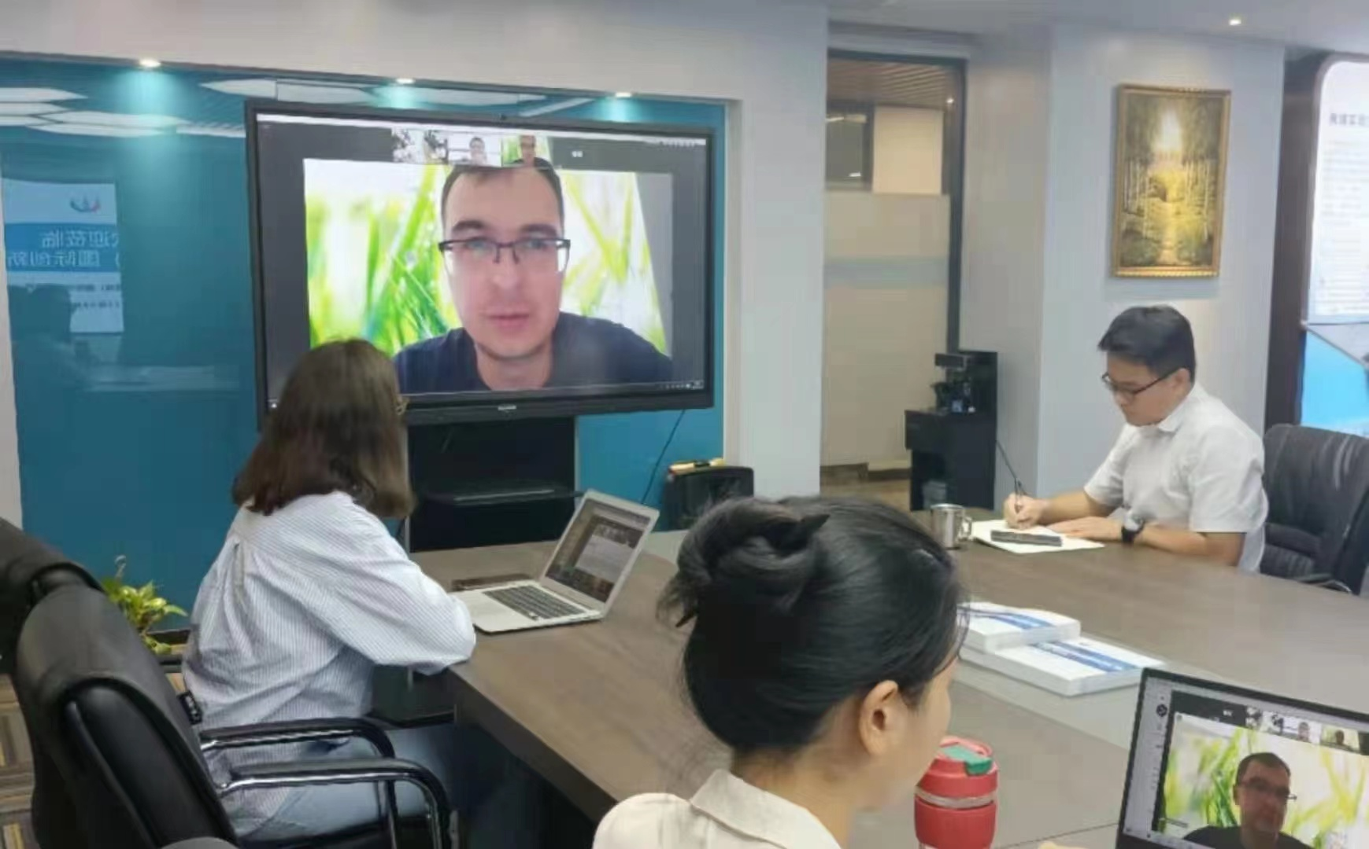
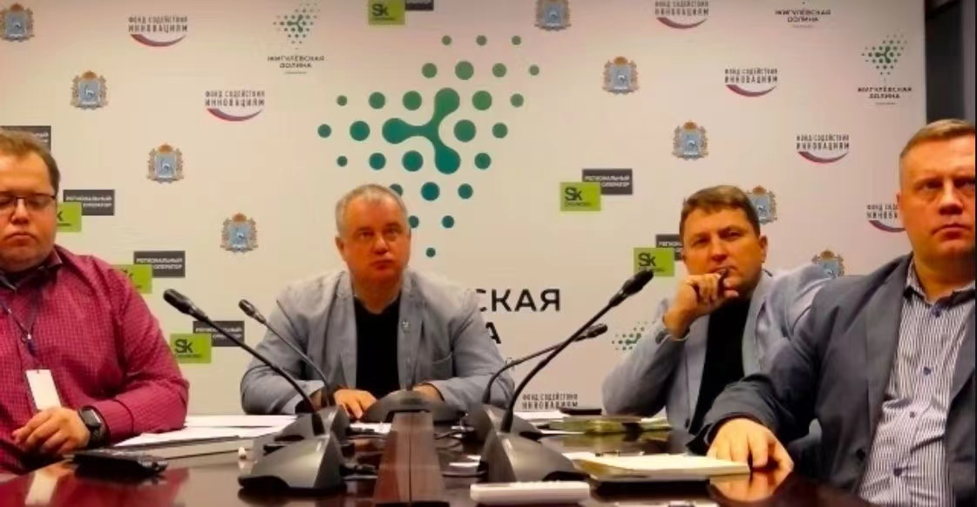
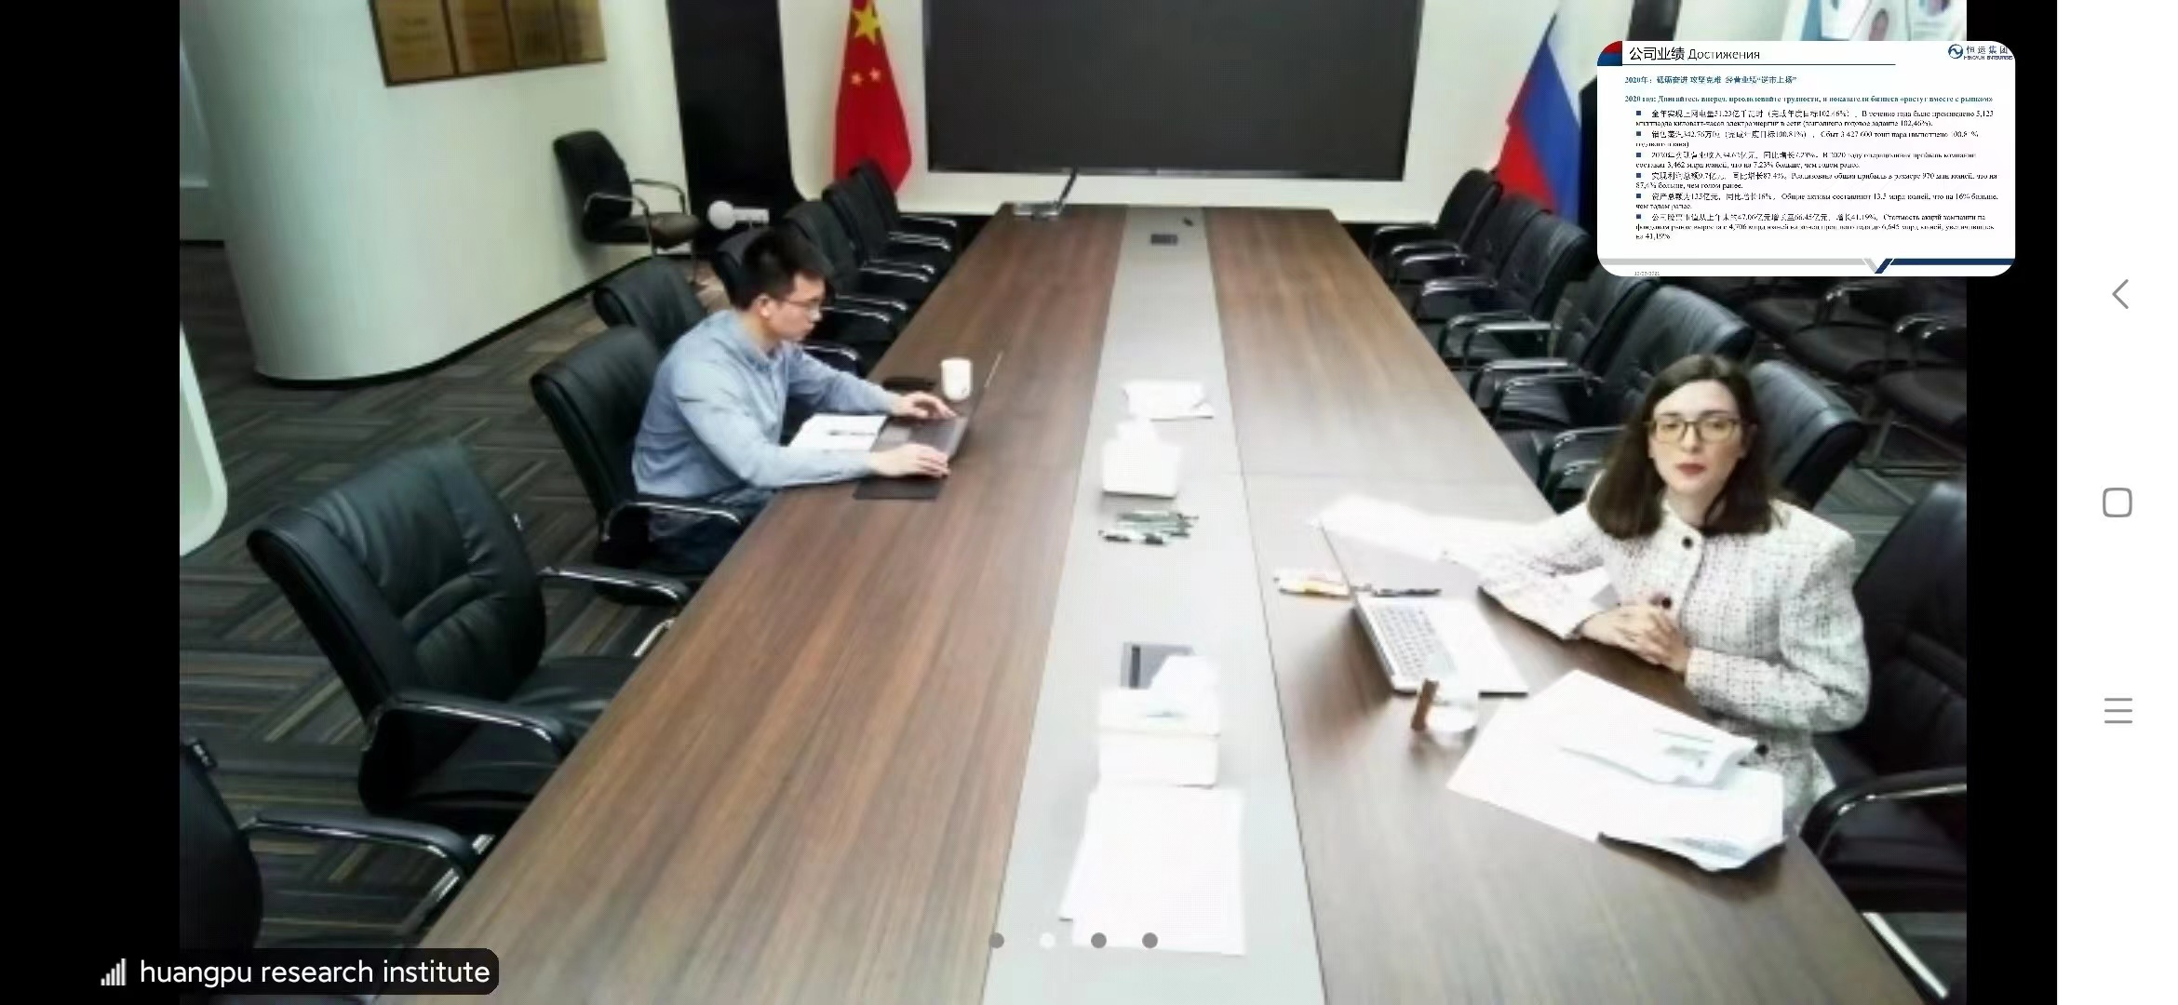
Key details of the project
Аreas of cooperation
04
Attraction of foreign talents
Introduce high-end talents, leading talents, academicians and their teams from CIS countries.
A project is underway with the Guangdong-Hong Kong-Macao Greater Bay Area Aerospace Research Institute and with the institute of Academy science of Russia to attract young talented specialists to work at the institute
03
Organization of international conferences and tweening town cooperation
2022. 04.19 After the opening of the Guangzhou town representative office in Minsk, Belarus, organized of a series of events with the participation of experts from the Belarusian Institute for Strategic Studies and experts from the Guangdong Institutes for Belarus and CIS Studies.
2021.09.28, the signing ceremony for the signing of sister cities between Guangzhou and Minsk was held. Guangzhou Mayor Wen Guohui, Belarus Minsk Executive Committee Chairman Kukharev, Chinese Ambassador to Belarus Xie Xiaoyong, Belarusian Ambassador to China Xianke, General of Belarus Popov attended the meeting.

Slide 12
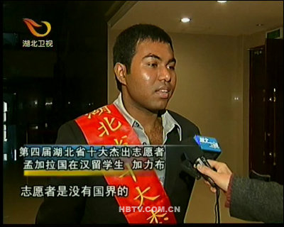
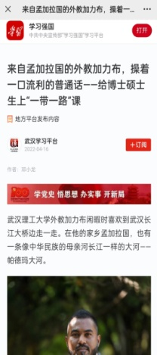
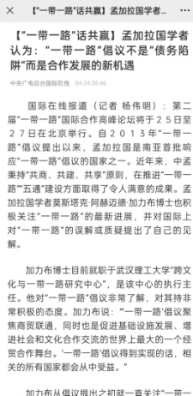
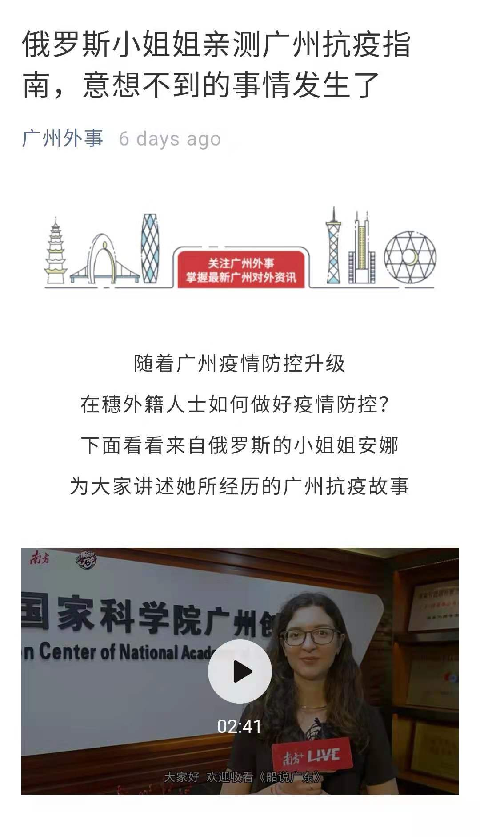
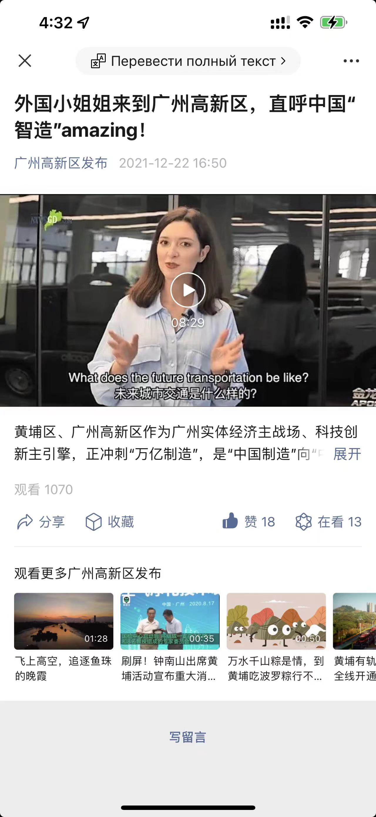
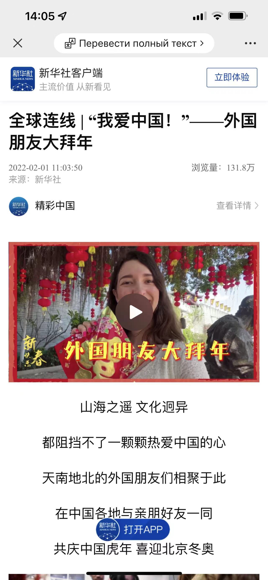
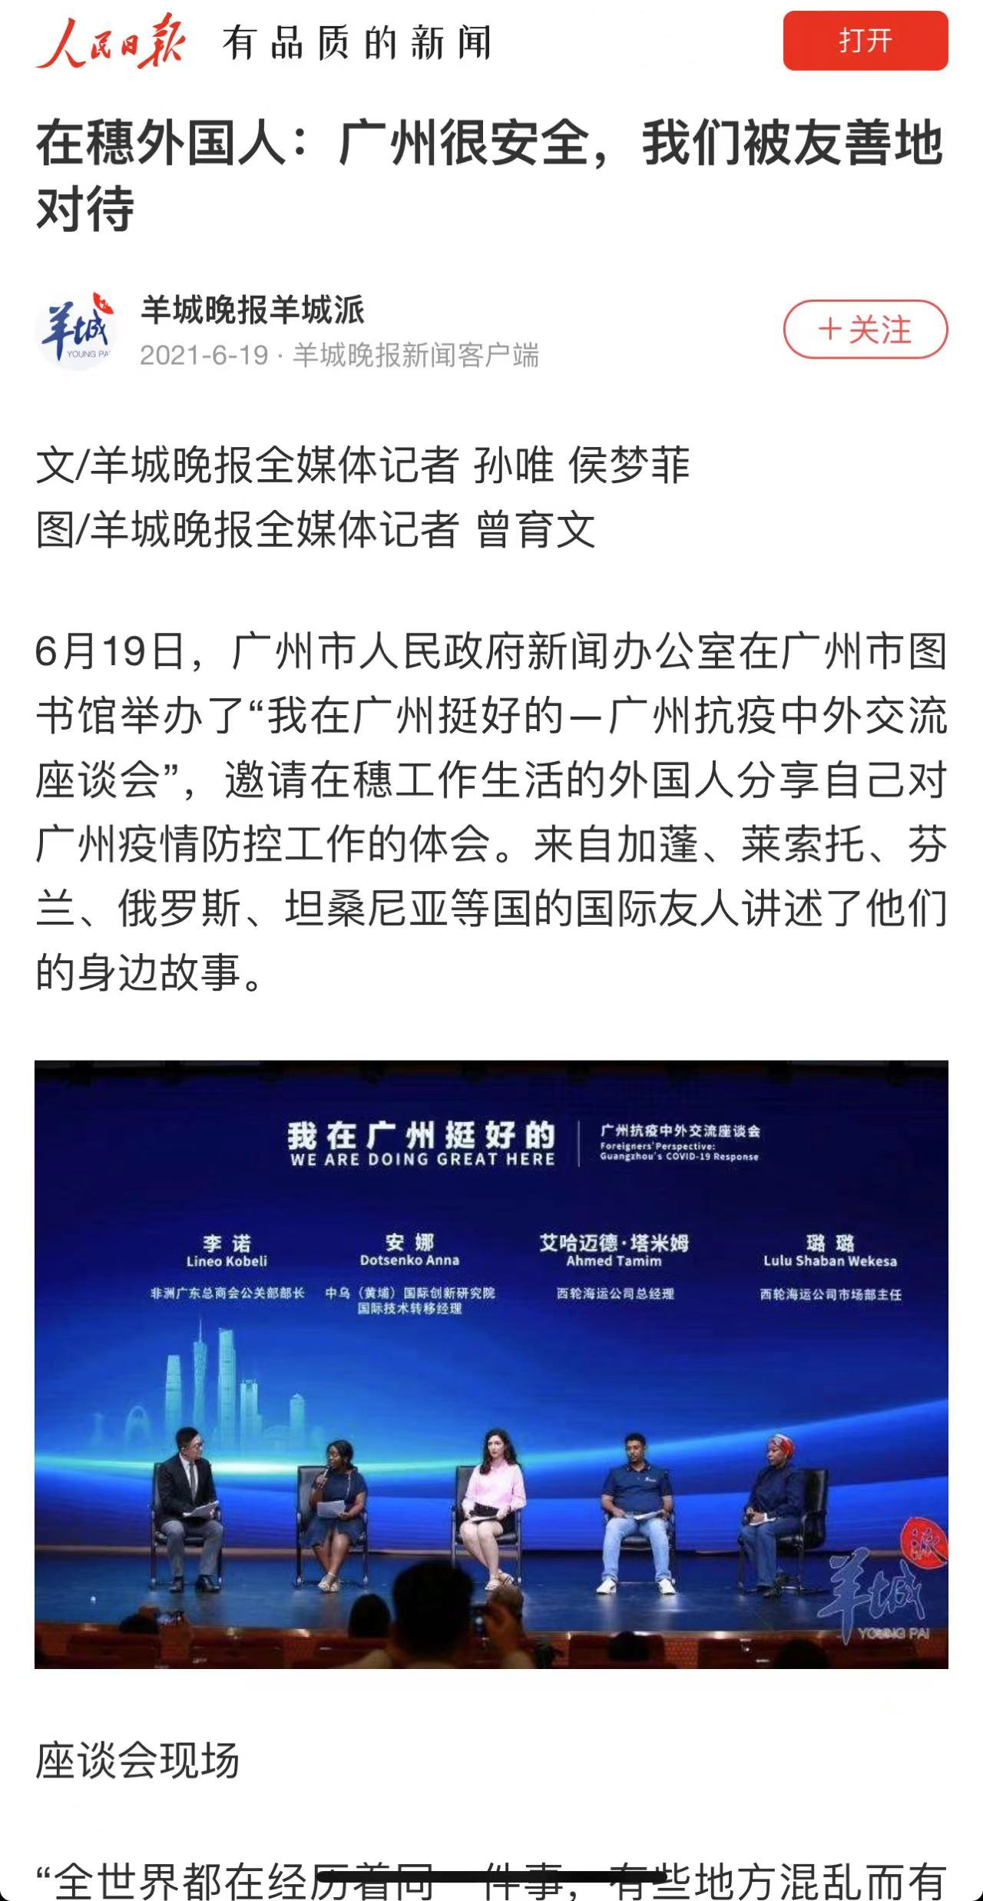
Key details of the project
We are the bridge between China and “One belt, one road” countries
Anna Dotsenko
Mostak Ahamed Galib
International Technology Transfer Manager of Huangpu International Innovation Institute.
He has long been engaged in international scientific and technological cooperation and promotion tasks with Russia, Belarus, CIS countries according to new materials, energy conservation and environmental protection, and intelligent equipment manufacturing technology in South China.
Director, Cross cultural communication and BRI research center, Wuhan university of technology.
Research area includes, people to people bond, community of shared future, BRI initiative, international cooperation.
In May,2015 praised by vice premier Liu yandong as “ youth ambassador”
Received various prestigious award as “May 4th gold medal”, “CCTV-most popular person of the year 2007”
学习强国
中央广电总台
广东外事
广州开发区
新华社
人民日报

Slide 13
3
Videos` overview
1. The future of intelligent transportation looks at foreign world
2. How to be “smart”in Guangzhou?
3. The tale of a bridge

Slide 14
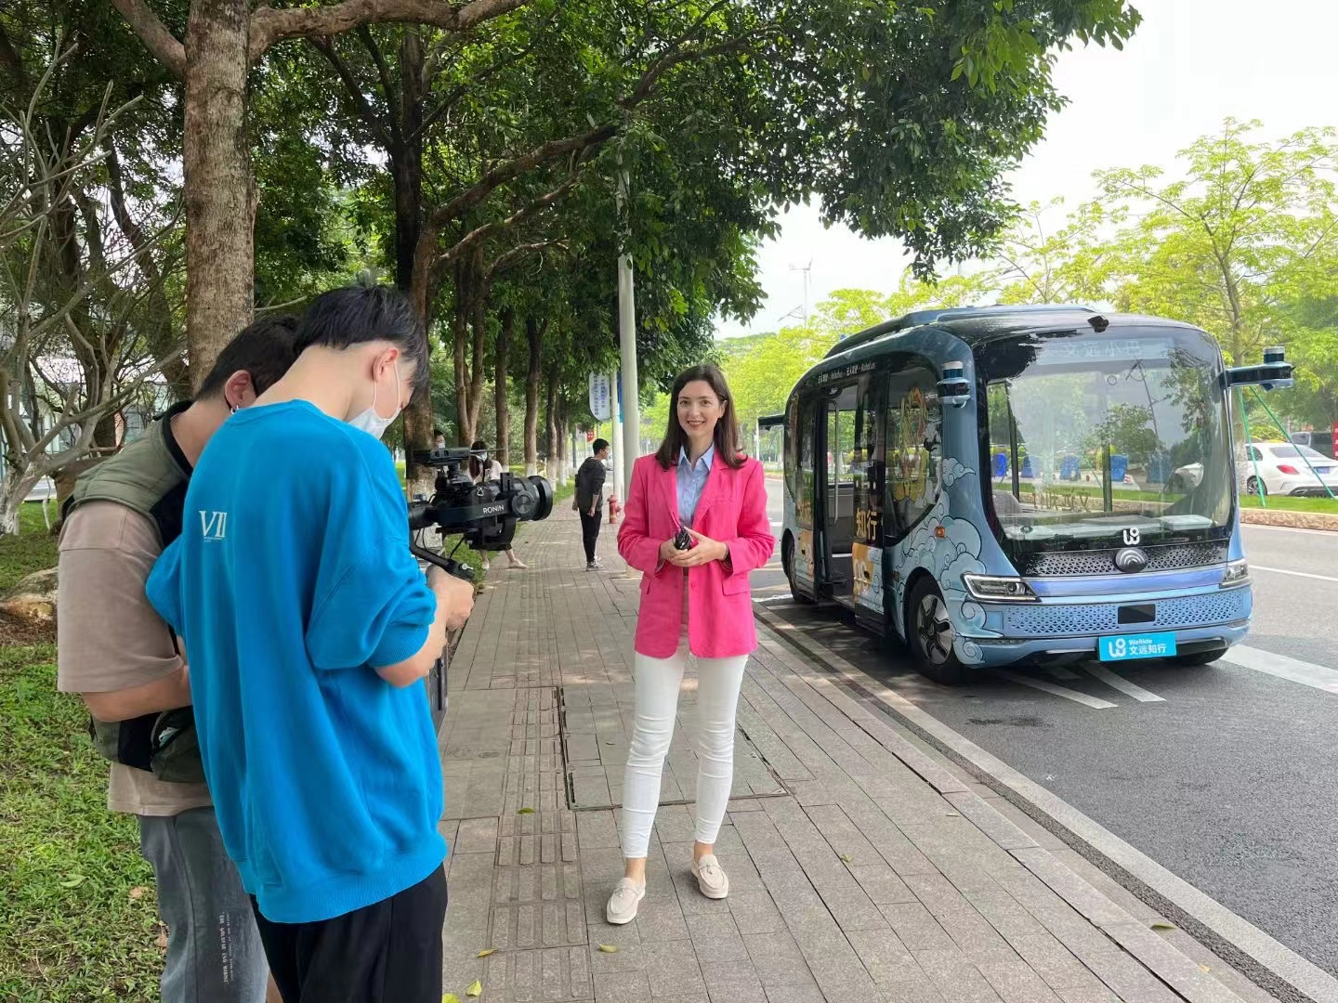
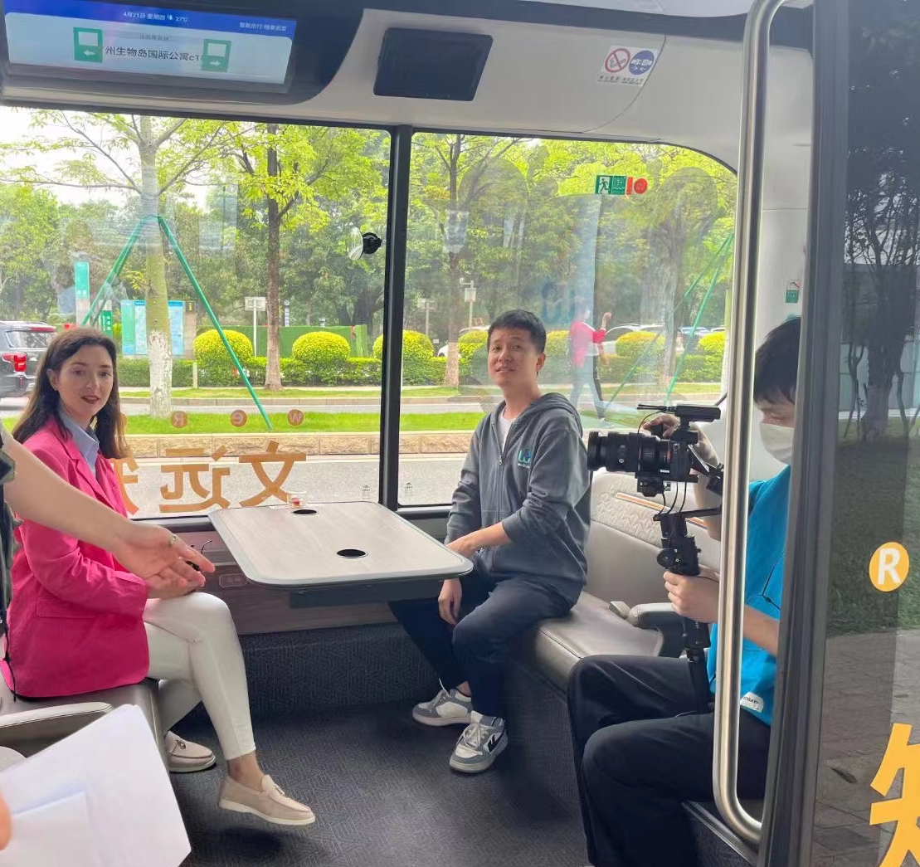
Videos` overview
1. The future of intelligent transportation looks at foreign world
Unmanned bus
Now Guangzhou's fleet of unmanned buses is one of the largest in the world. Foreigners and locals are happy to use the technology of the future. The company is also ready to develop the technology to other countries.
Foreigners get to know the highly developed innovation environment and that everyone can benefit from this technology in China.
These measures are an example of the practical implementation of the concept of "creating an open, free innovative eco-environment" implemented by the Huangpu District government, demonstrates the creation of a favorable business environment here for further attracting representative offices of Fortune Global 500 companies and international research centers to the metropolis.

Slide 15
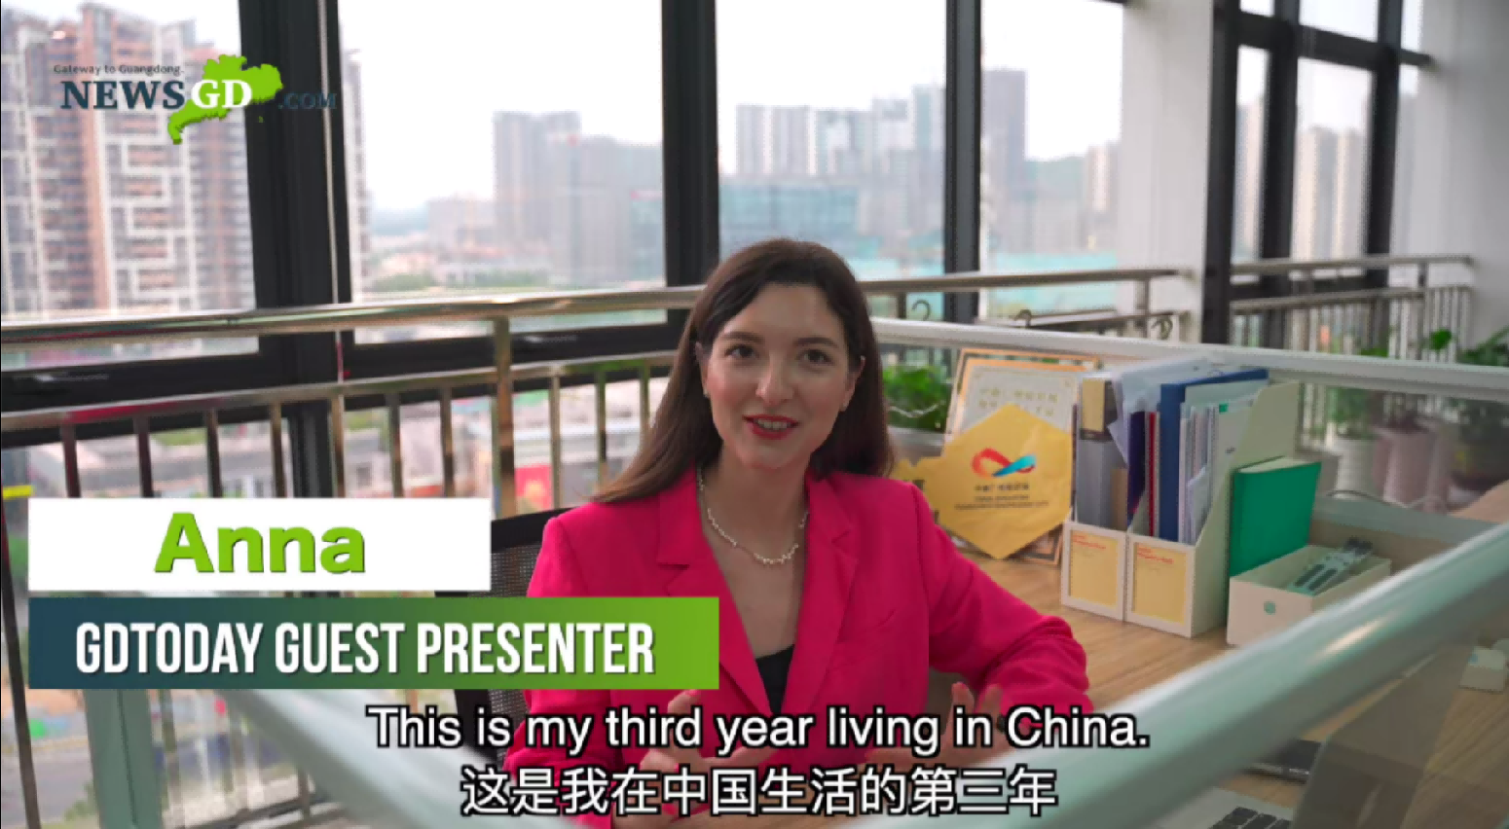
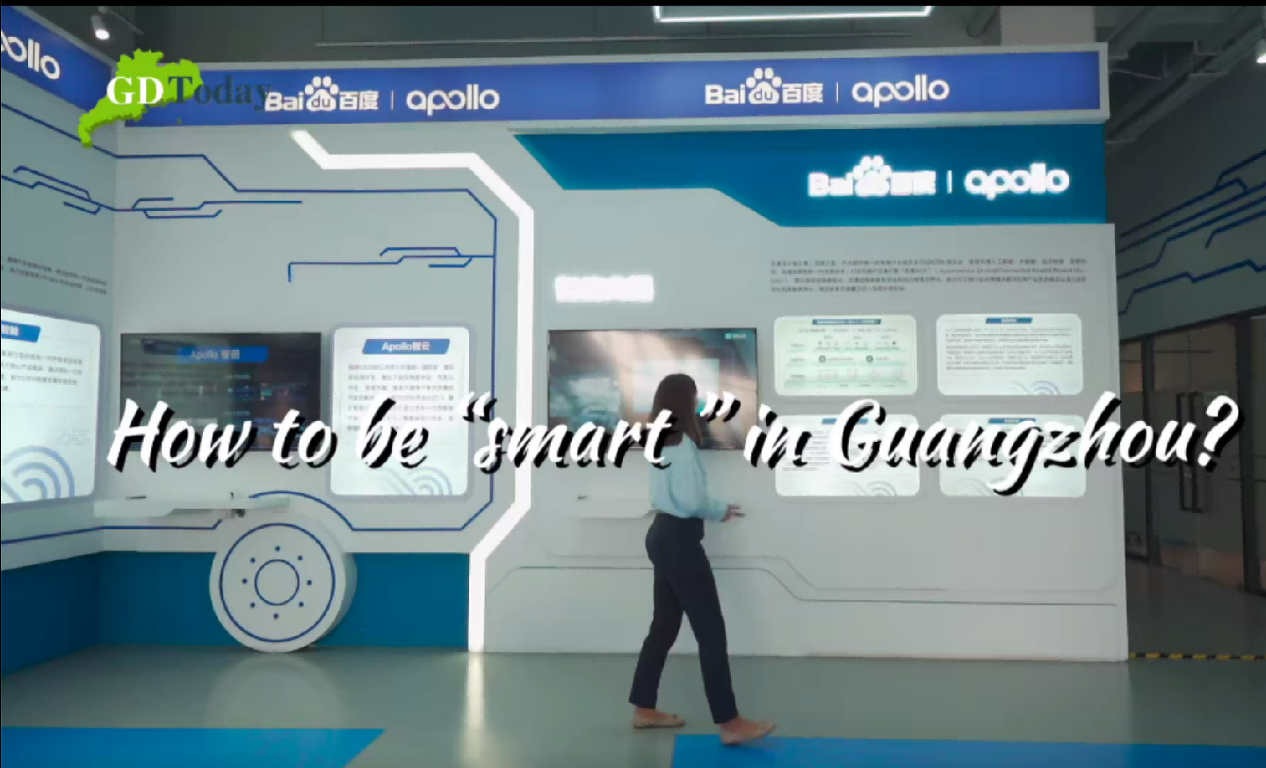
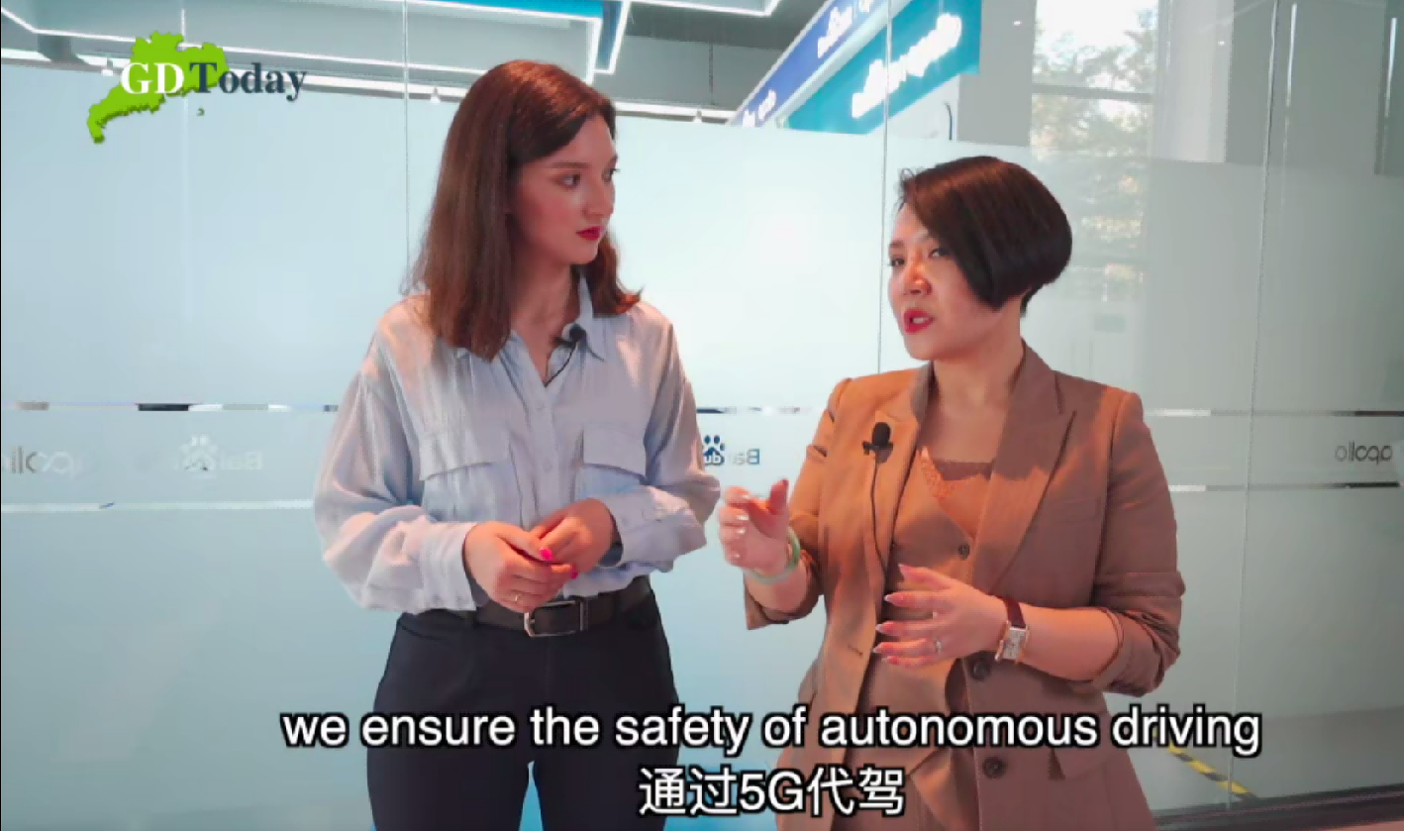
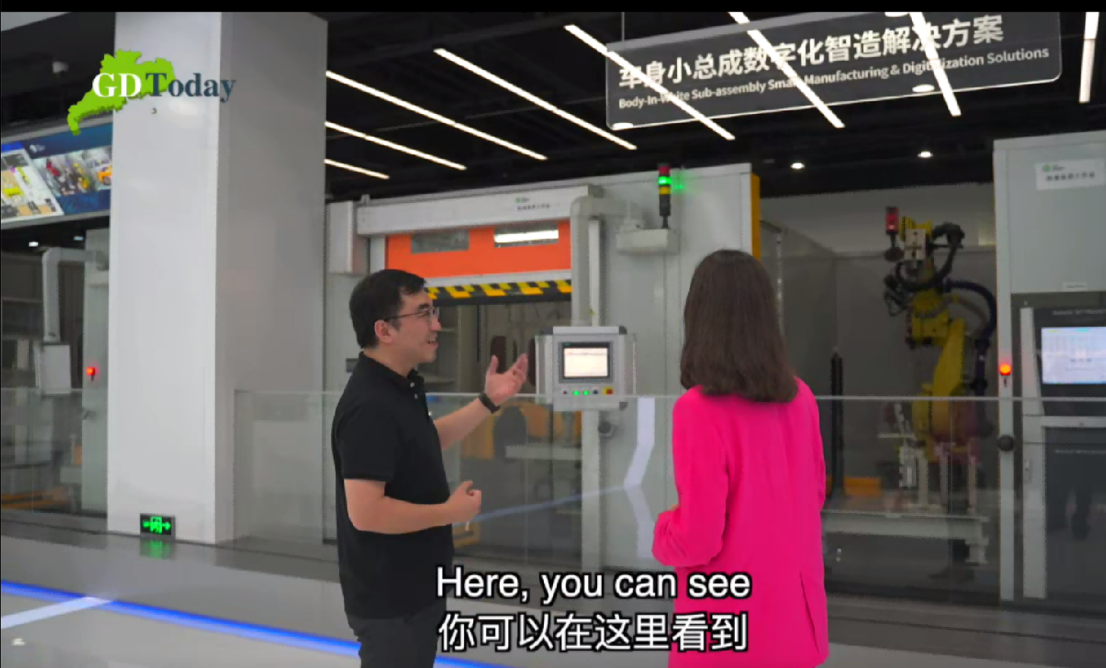
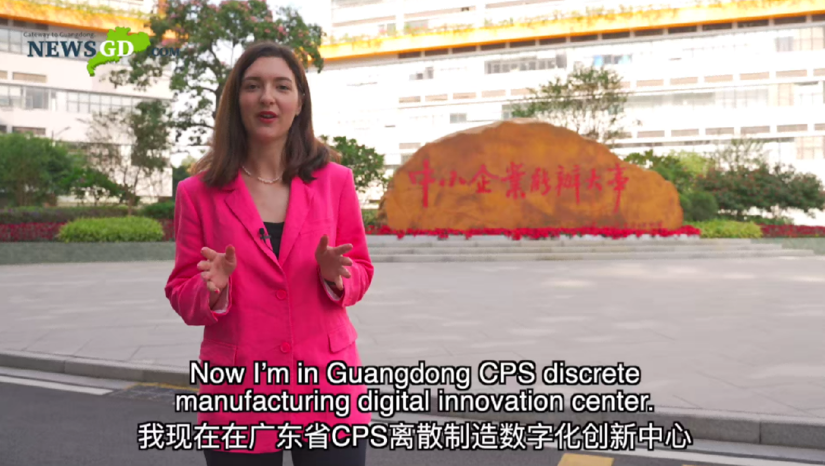
Videos` overview
2. How to be “smart”in Guangzhou?
Intelligent manufacturing
Guangzhou is the largest city in the southern part of the country and a real example of reform and "opening up", making conditions to promote the development of innovative industries such as a new generation of information technology, artificial intelligence, biomedicine, new energy resources, new materials.
Young scientists go abroad to study, then return to China to continue research on intelligent assembly by robots in the factory, ranging from automatization to digitalization, then realize it on real factories and cooperate with foreign factories.
The development of the scientific and technological sphere is freely open to the whole world for joint research and use of developments.

Slide 16
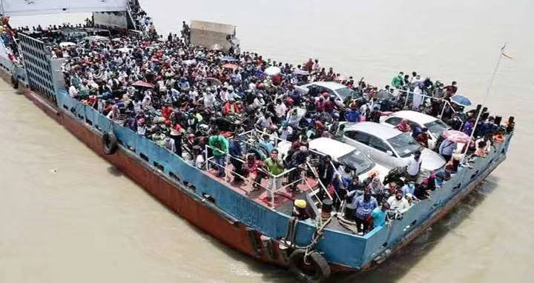
Videos` overview
3. The tale of a bridge!
The padma bridge
The southwestern Bangladesh is relatively poor, this zone is heavily suffering from global warming and salinity issues padma bridge will connect southwestern Bangladesh with the capital city and will create massive opportunity for more than 20 million climate refuges living there. Its china ,who actually did something for the climate refuges while other developed countries are yet to do anything positive rather than saying.
As some people say there is a so called “debt trap” in the BRI project, The padma bridge is a good example of “win-win cooperation” where both Bangladesh and China worked together to build a “community of shared future”.

Slide 17
4
Plan of work
Release to the platforms and main steps

Slide 18
Plan of the work
3. Release on the platfroms
The content of each phase generally includes interviews with local enterprises, interviews with representatives of China's innovative image. For exxample”Made in Guangdong”
Each month post some videos, which according on the Main area and “hot”topic
Select main areas
Regularly posting
02
04
01
03
Choose suitable platforms
Publish in relevant media
we look forward to supporting and cooperating with the China Foreign Language Publishing Administration, relevant media and Chinese television.
Choose platforms for broadcasting:
Anna: unites foreigners as the bright driving force of the promotion of the history of open China abroad. acts as a presenter in commercials, interviews foreigners living in China and leading enterprises. helps to connect with innovative enterprises, incubators, technology parks.

Slide 19
THANKS
谢谢大家

