Slide 1
Model SCO: Learning empathy through “Shanghai Spirit”
Topic: Open cooperation and Interconnectivity
Team: SCOLAR Network
Submitted by: Shikha Thapa Magar
Date: 24 May 2022

Slide 2
Notice on Copyright and Confidentiality of Information
This presentation is the property of SCOLAR Network – SCO Countries Youth Platform. It contains confidential information intended only for the party to whom it is transmitted.
Distribution, circulation, copy, reproduction, as well as implementation of any actions based on the information of the document, in whole or in part, without prior written consent of SCOLAR Network, is prohibited.

Slide 3
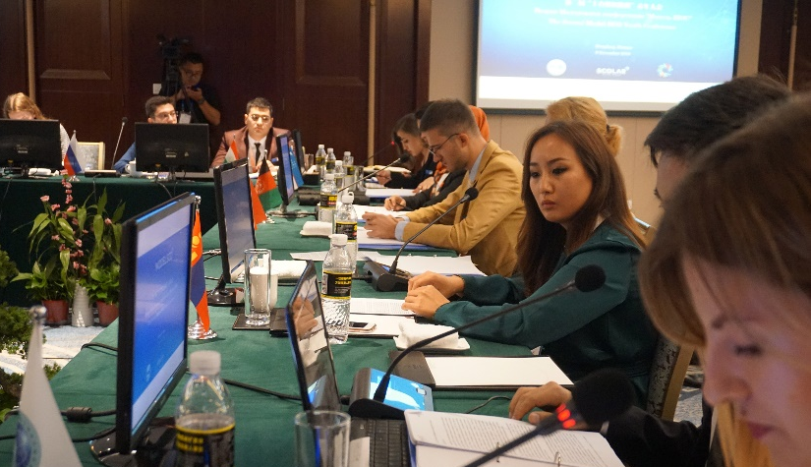
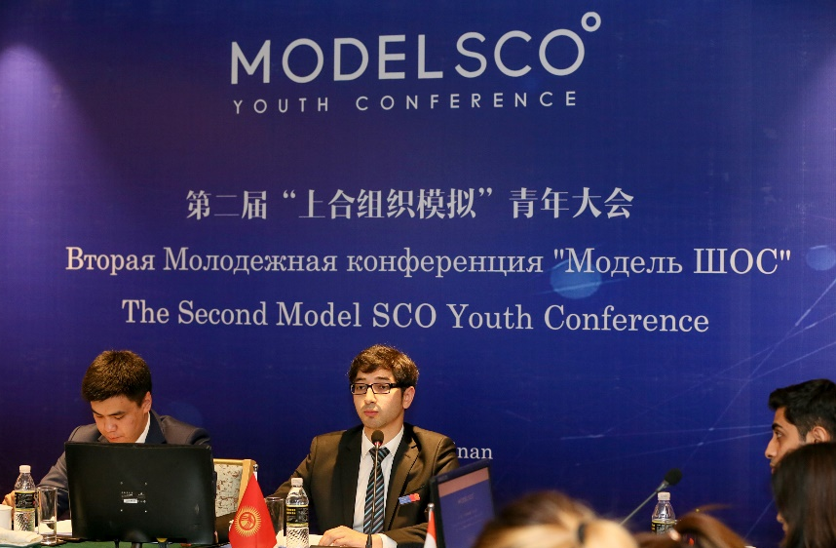
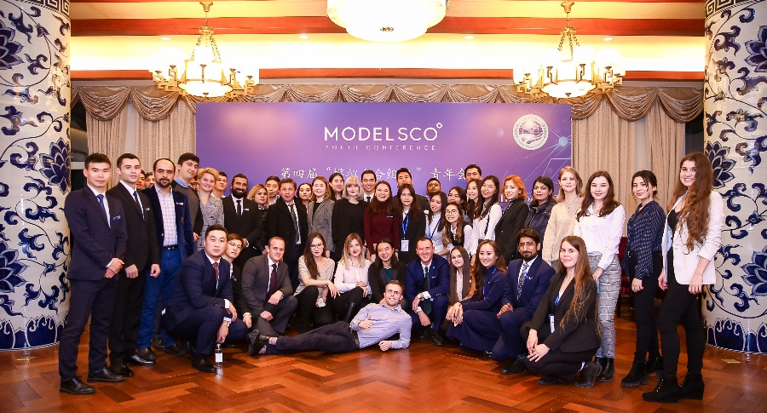
About SCOLAR Network
SCO Countries Youth Platform (SCOLAR Network) is a platform aimed at bringing together young leaders from 18 Shanghai Cooperation Organization (SCO) countries to strengthen connectivity, promote dialogue and contribute to regional development.
Founded on April 17th, 2017, and affiliated with the SCO Secretariat in Beijing, SCOLAR takes the “Shanghai Spirit” principles as a guide in its mission to strengthen the role of youth in developing their countries and the Eurasian region as a whole. The "Shanghai Spirit“, as a combination of the founding values of the SCO, includes mutual trust, mutual benefit, equality, consultation, respect for cultural diversity, and pursuit of common development. SCOLAR projects today include “Thought Leader” and Deep Dive series, as well as flagship events “AGORA: SCOLAR Vision” Youth Conference, “Model SCO” and SCOLAR Academy. SCOLAR organizes more than 60 events in a year in Beijing, Wuhan, Lanzhou, Nanjing, Kathmandu, Saint Petersburg, etc.
SCOLAR Network works closely in partnership with institutions and organizations worldwide, including China Youth Center for International Exchange, Innoway (China's Silicon Valley), Taihe Institute, Tsinghua University, WEF Global Shapers Community, APEC Voices of the Future China and others.

Slide 4
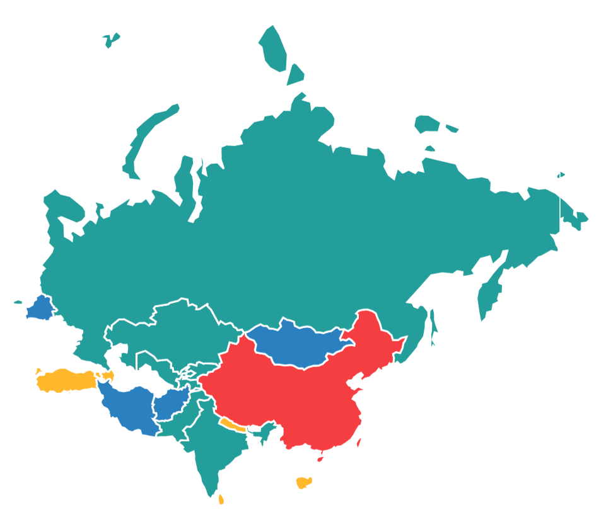
About SCO
The Shanghai Cooperation Organization (SCO) is the biggest intergovernmental international organization created on 15 June 2001 in Shanghai (China) by 6 neighboring countries: the Republic of Kazakhstan, the People's Republic of China, the Kyrgyz Republic, the Russian Federation, the Republic of Tajikistan, and the Republic of Uzbekistan.
SCO Family today
9
8
Dialogue Partner States
Member States
4
India
Kazakhstan
China
Kyrgyzstan
Pakistan
Russia
Tajikistan
Uzbekistan
Azerbaijan
Armenia
Egypt
Cambodia
Qatar
Nepal
Saudi Arabia
Turkey
Sri Lanka
Observer States
Afghanistan
Belarus
Iran
Mongolia

Slide 5
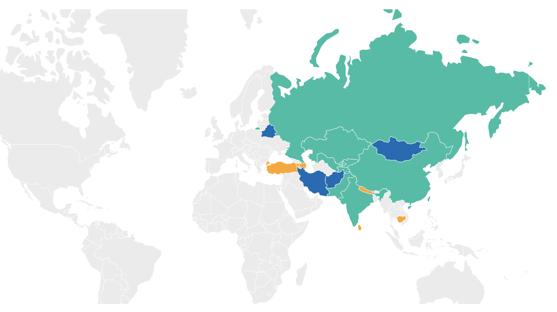
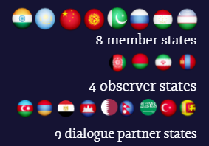
What is SCO?
44%
of the world
population
29%
of the world territory
22%
of the world GDP

Slide 6
SCO Structure
The Heads of State Council (HSC) is the supreme decision-making body in the SCO. It meets once a year and adopts decisions and guidelines on all important matters of the organization.
The SCO Heads of Government Council (HGC) meets once a year to discuss the organization's multilateral cooperation strategy and priority areas, to resolve current important economic and other cooperation issues, and also to approve the organization's annual budget.
The Council of National Coordinators of SCO Member States (CNC) acts as the SCO coordination mechanism.
The organization has two permanent bodies — the SCO Secretariat based in Beijing and the Executive Committee of the Regional Anti-Terrorist Structure (RATS) based in Tashkent.

Slide 7
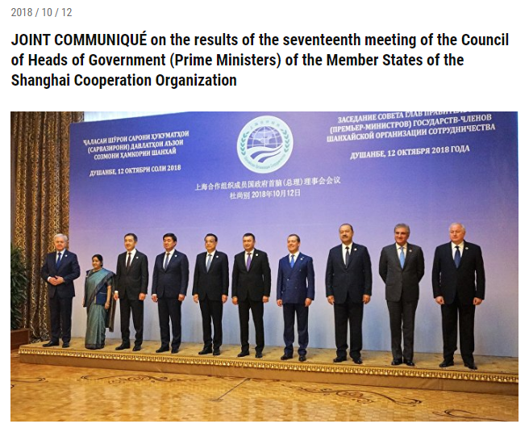
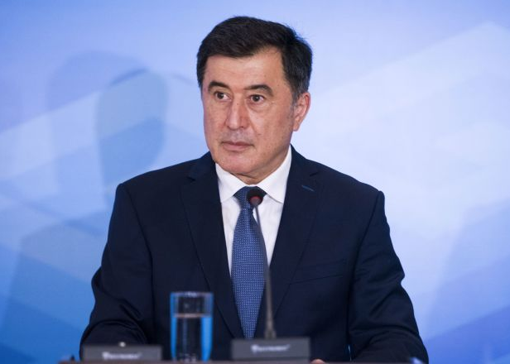
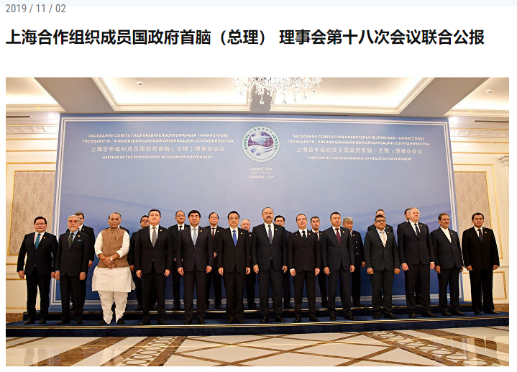
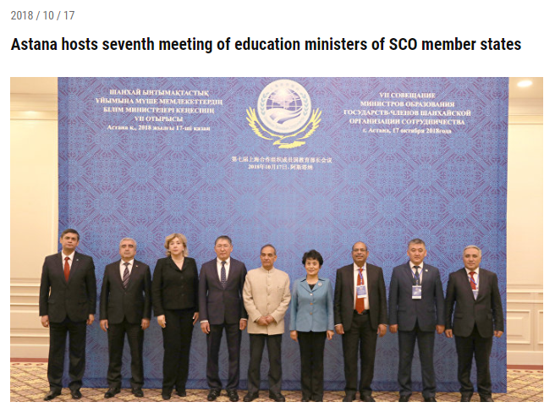
About Model SCO
"The interactive game "Model SCO" demonstrated the growing interest of young people in the activities of the Organization aimed at strengthening mutual trust, friendship and good-neighbourliness between the peoples of our countries. In this regard, we consider it important to disseminate the experience of the interactive game "Model SCO" and the volunteer youth movement "SCOLAR" in all countries of the SCO family with the active support of the national Youth Councils of the SCO”.
SCO Secretary General Vladimir Norov,
June 13, 2019, Bishkek
The “Model SCO” was noted in the Joint Communiqué of the seventeenth meeting of the Council of Heads of Government (Prime Ministers) of the SCO member states in Dushanbe
(October 12, 2018)
The MSCO was also mentioned in the Joint Communiqué of the eighteenth meeting of the Council of Heads of Government (Prime Ministers) of the SCO member states in Tashkent
(November 2, 2019).
The project also was mentioned during the seventh meeting of Ministers of Education of member states of the SCO in Astana (October 17, 2018)

Slide 8
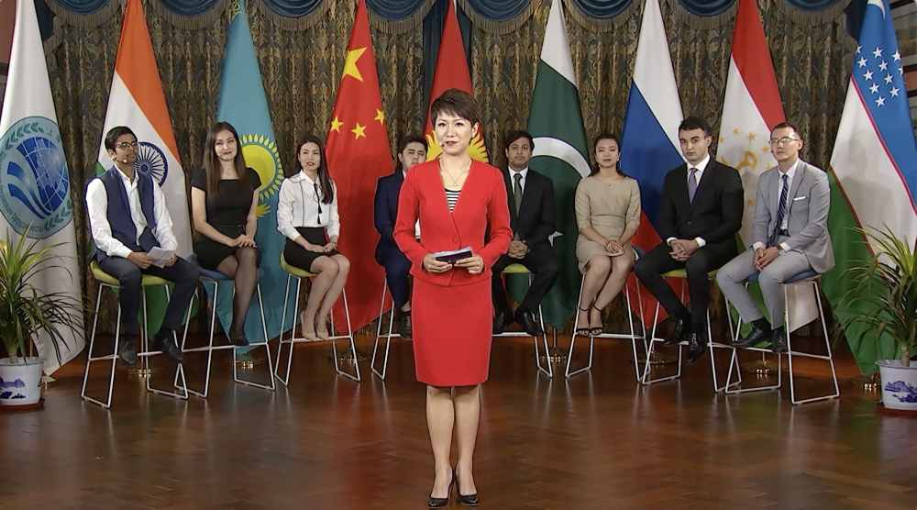
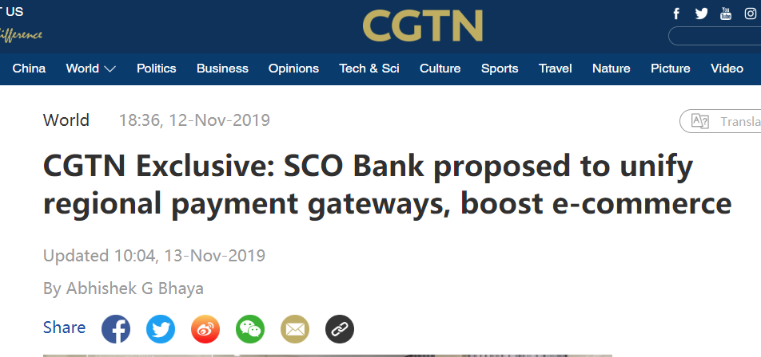
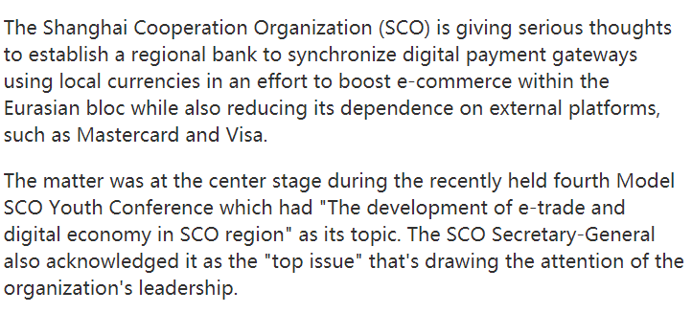
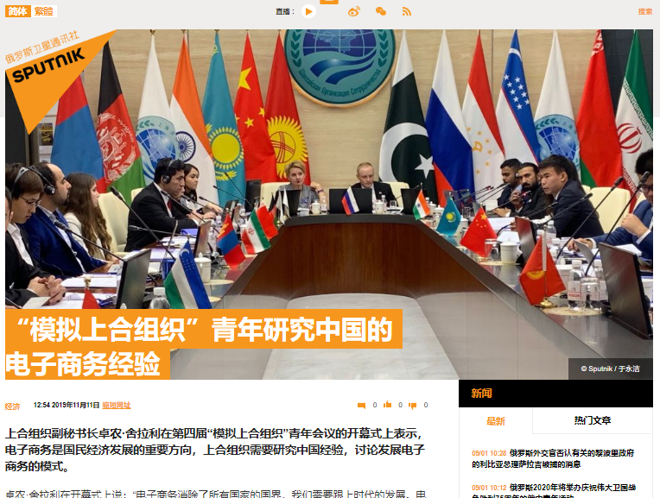
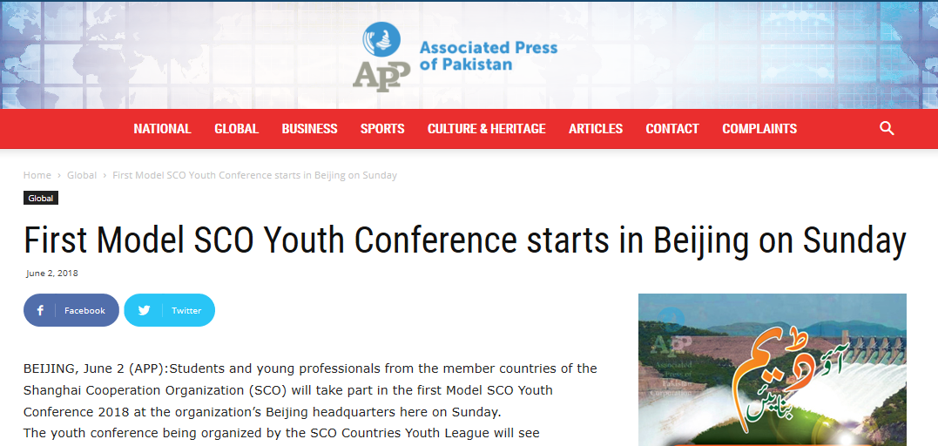
Impact
TASS on Model SCO, November 2018
CGTN program The Point with Liu Xin 30к views on CGTN YouTube channel
CGTN on Model SCO, November 2019
SPUTNIK on Model SCO, November 2019
Associated Press of Pakistan
on Model SCO,
November 2018

Slide 9
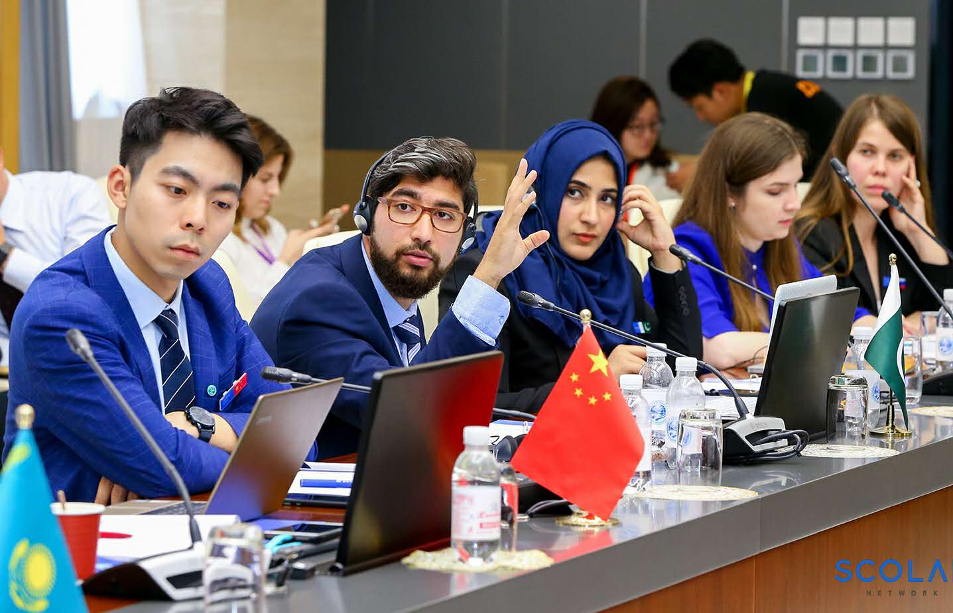
What is Model SCO?
“Model SCO” (MSCO) – is an educational interactive game (conference-simulation) that simulates the work of the bodies of the Shanghai Cooperation Organization (SCO). Model SCO is conducted by students and young professionals interested in studying the functions and operation of the SCO. The game has educational goals and gives delegates the opportunity to study international relations and diplomacy, improve writing skills, communicate with international students from other SCO countries, work in a team, lead discussions and develop new ideas and projects.
The rules of procedure and the game protocol are modeled in accordance with fundamental documents of SCO and imitate the summits and meetings within the SCO.
Delegates represent SCO member and observer states.
Consensus is the main decision-making principle.
The languages of the conference are Chinese, Russian, and English.

Slide 10
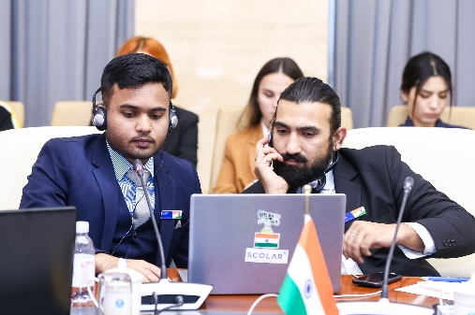
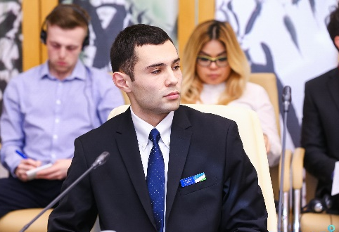
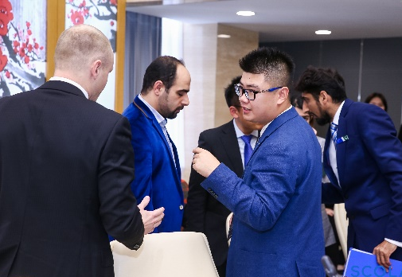
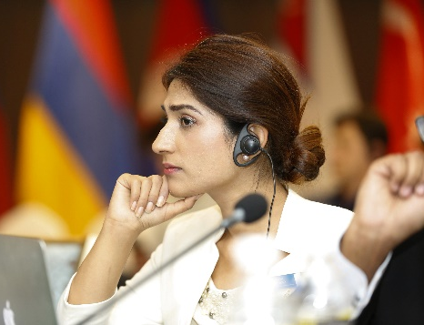
Why Should I join Model SCO?
Writing skills Public speaking
Diplomacy
Negotiations
Empathy
Leadership skills
Networking
Academic Preparation
Future career
Experience for working in International Organization

Slide 11
What to simulate?
The Council of Heads of Government (Prime Ministers) (CHG)
Participants: member and observer states
Agenda: economics and finance related topics
8
Member States
The Council of Heads of States (Presidents) (CHS)
Participants: member and observer states
Agenda: covers all topics, including security issues, politics, economy, culture, etc.
The Council of Ministers of Foreign Affairs
(CMFA)
Participants: member states only
Agenda: foreign affairs and diplomacy related topics
India
Kazakhstan
China
Kyrgyzstan
Pakistan
Russia
Tajikistan
Uzbekistan
4
Observer States
Afghanistan
Belarus
Iran
Mongolia
Meetings of Heads of Ministries and/or Agencies
Participants: member states only
Agenda: depends on the simulated Ministries and/or Agencies
The Council of National Coordinators (CNC)
Participants: member states only
Agenda: covers all topics, including security issues, politics, economy, culture, etc.
2 delegates per Member State
1 delegate per Observer State
1 delegate as the Secretary General
1 delegate as the Director of RATS*
*RATS stands for Regional Anti-Terrorist Structure

Slide 12
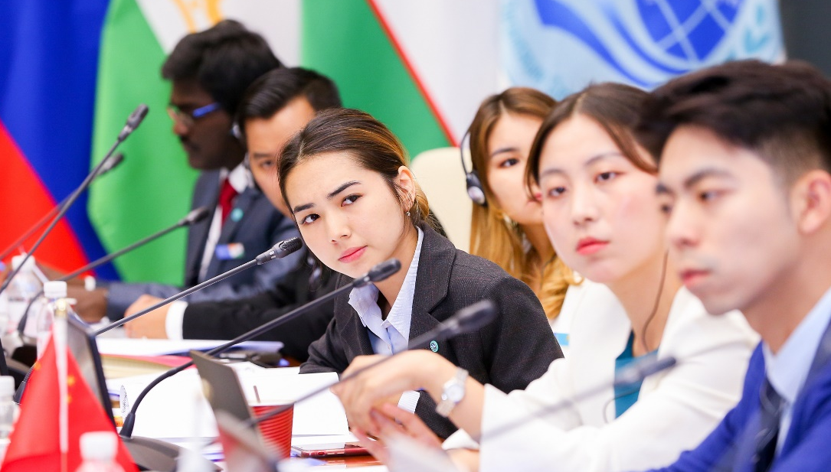
Problem of Statement
SCO region consists of 1 billion young population with the potential to improve society through commerce & trade, exchange of culture, innovation and cross-country cooperation of bilateralism or multilateralism along the Belt and Road initiative.
This region lacks a proper youth platform to connect and discuss the local issues in international media, which could be acknowledged.

Slide 13
Innovation
SCOLAR Network provides a perfect platform for the youth of SCO countries to connect and exchange dialogue and bring their local issues. And, this simulation is not only bringing youth together but also allows delegates to study international relations and diplomacy, improve writing skills, communicate with international students from other SCO countries, work in a team, lead discussions, and develop new ideas and projects.
Proper observation and feedback on the position paper drafted by the delegates give delegates real experience in international relations, diplomacy, and dialogue exchange. This guidance helps them be better decision-makers work under peer pressure to solve the raised problems.

Slide 14
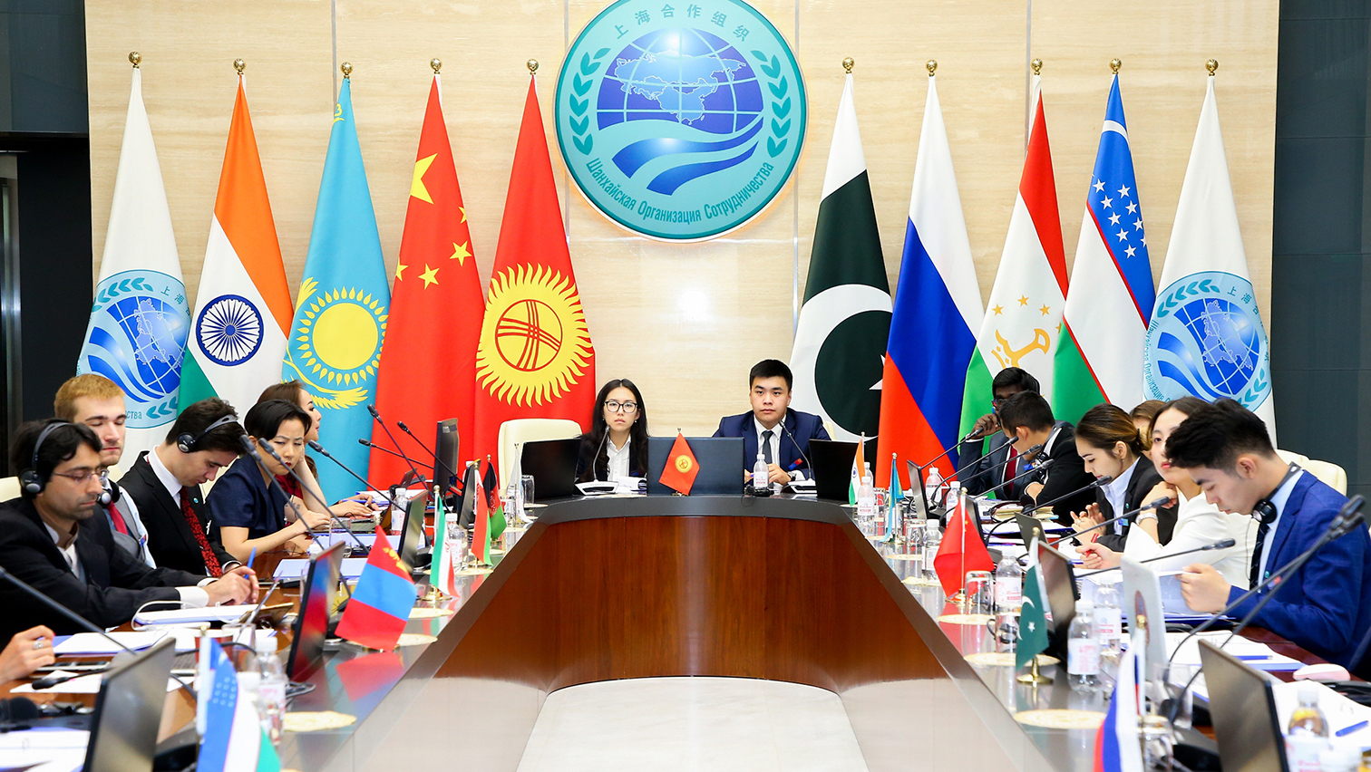
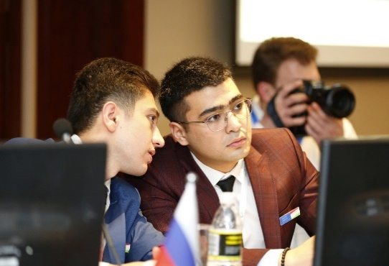
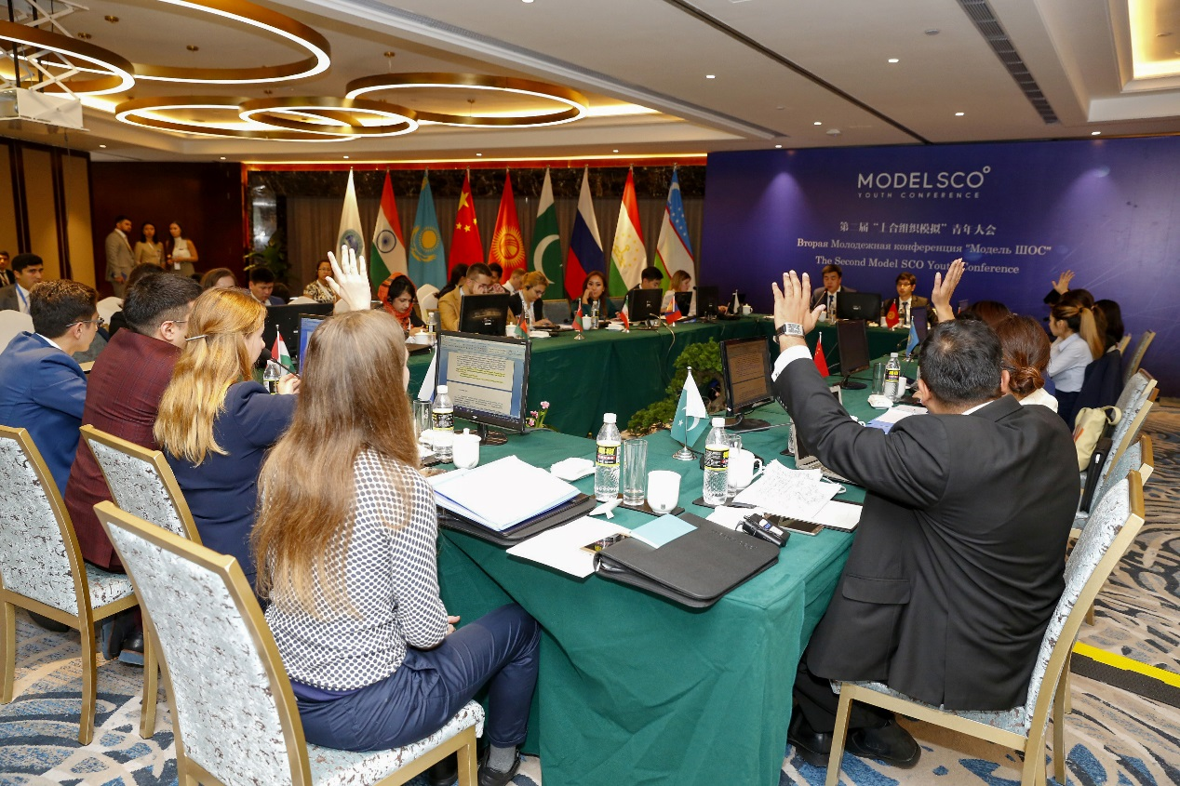
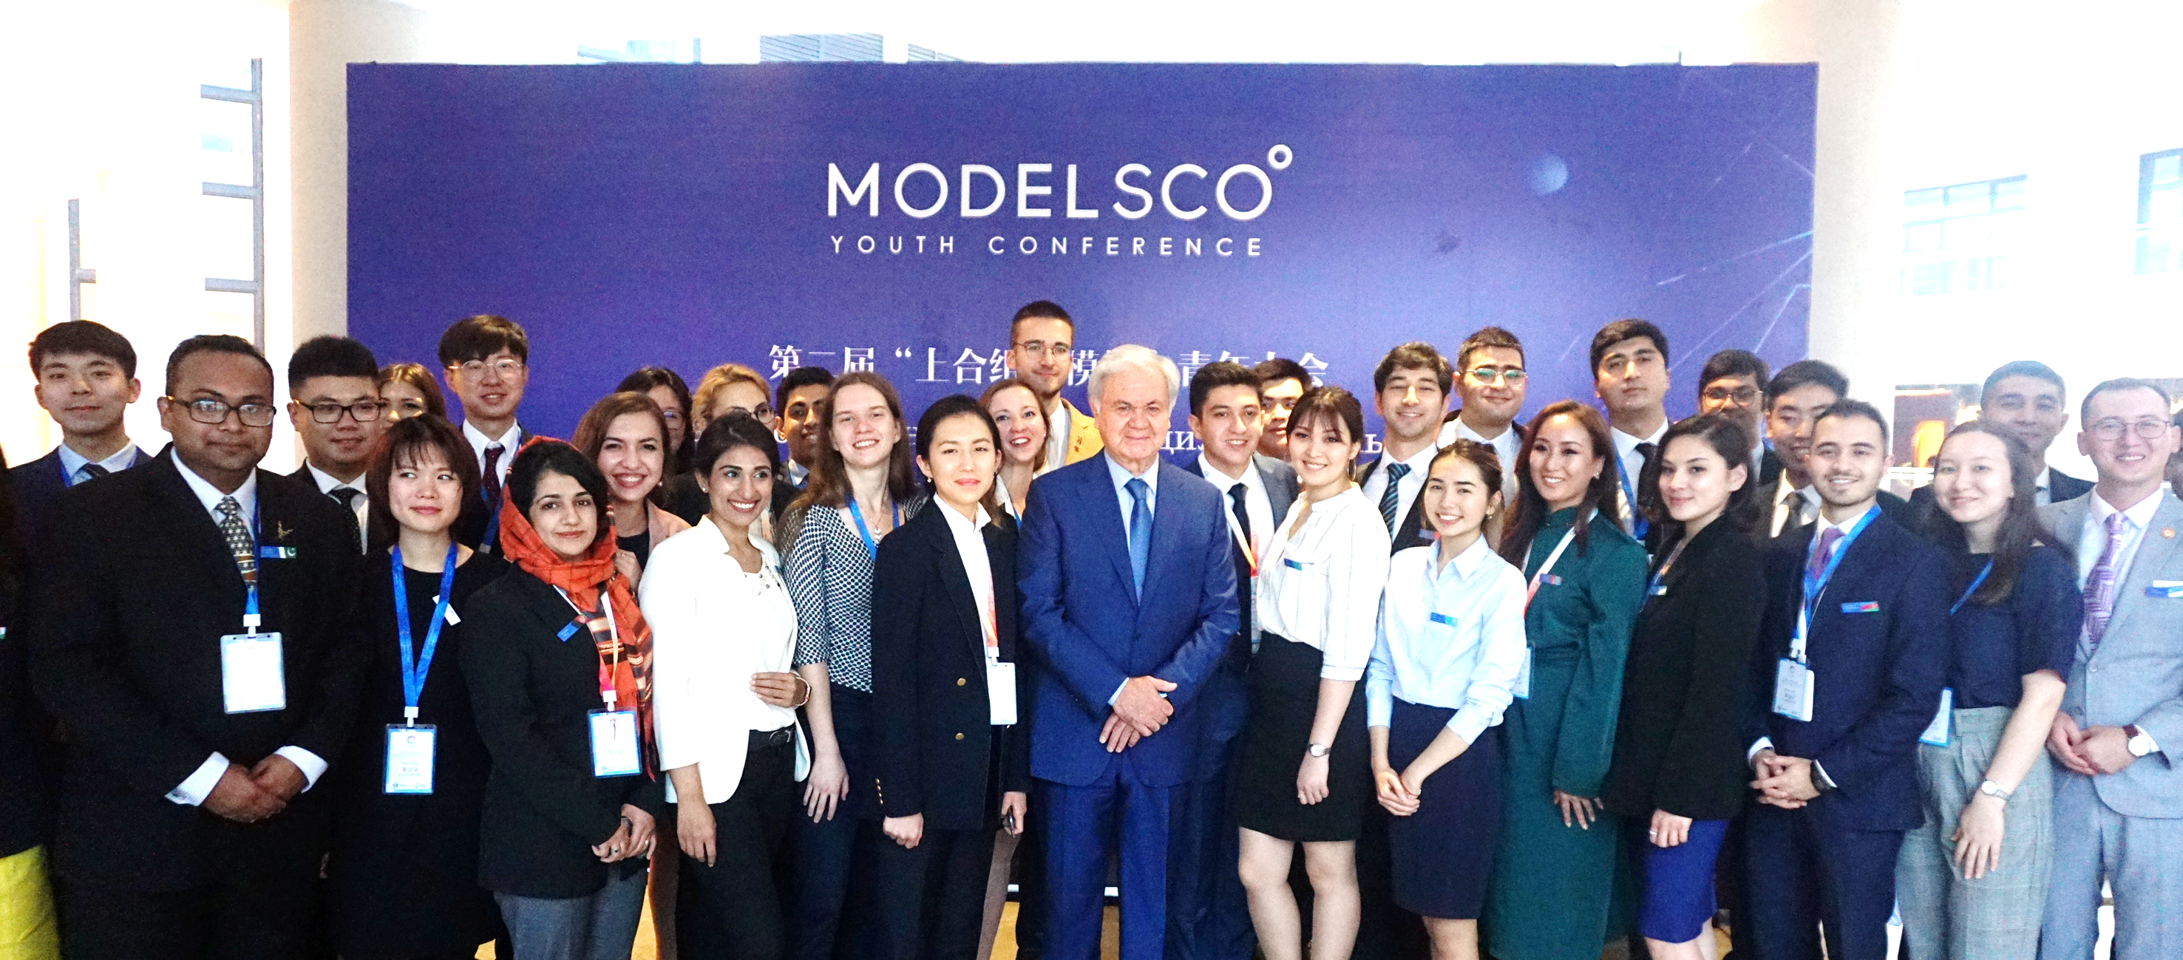
Project Format
Delegations
Regulations
The Main Documents

Slide 15
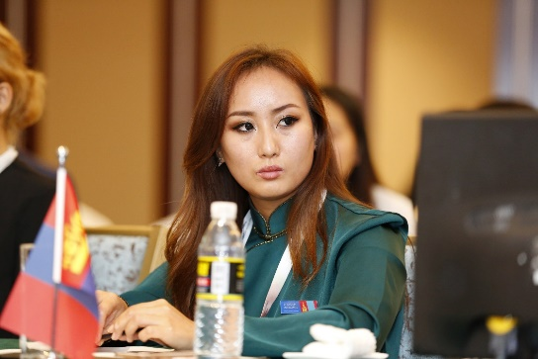
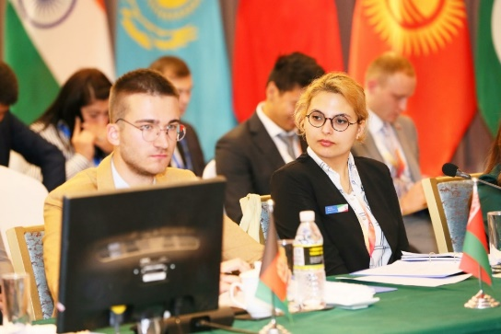
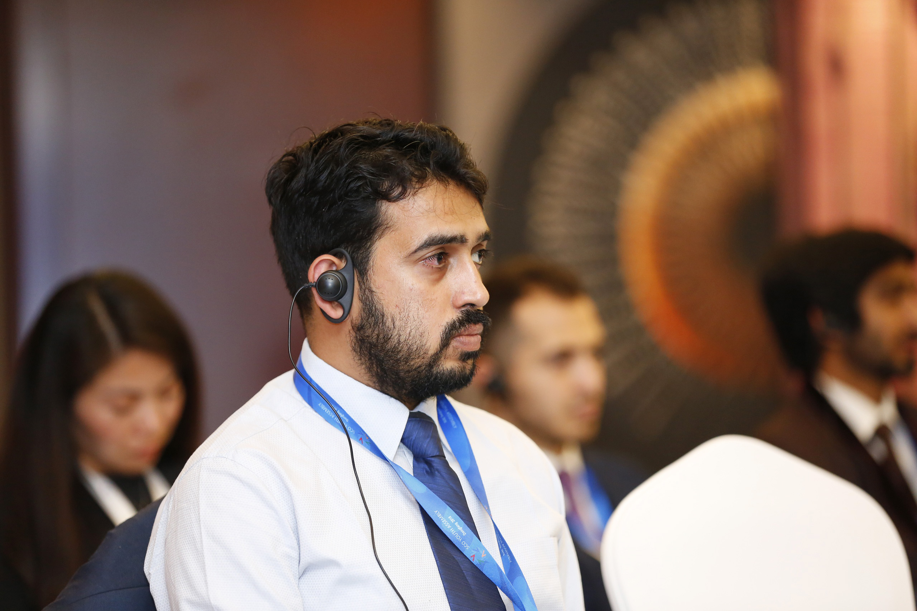
Delegations
Secretary General (SG)
The Secretary General (SG) is a key administrator in MSCO and is responsible for guiding of the Declaration of the participants. The Secretary General also gives a speech (after all the member states), in which he/she reports mainly on the activities of the SCO Secretariat within the topic raised.
Member states
The delegations of the member states consist of two delegates: Head delegate and Advisor. Head delegate reads Position Paper (speech) and leads discussion. Advisor helps Head delegate to write Position Paper and also participates in discussions.
Observer states
are represented by one delegate. Observers read their reports, participate in free discussions, share the positions of representing countries, give recommendations for the Declaration of the member states, but do not participate in the approval of the final version of the Declaration.
The Director of the RATS
The delegate from the RATS prepares a report on the activities of the Regional Anti-Terrorist Structure and helps the Secretary General to edit the text of the Declaration.

Slide 16
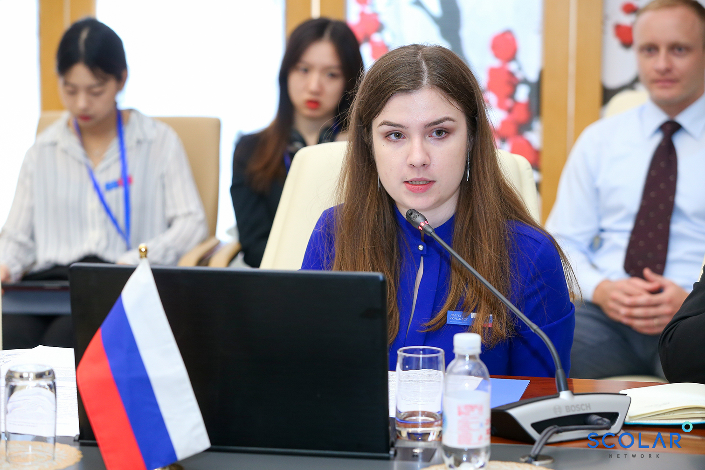
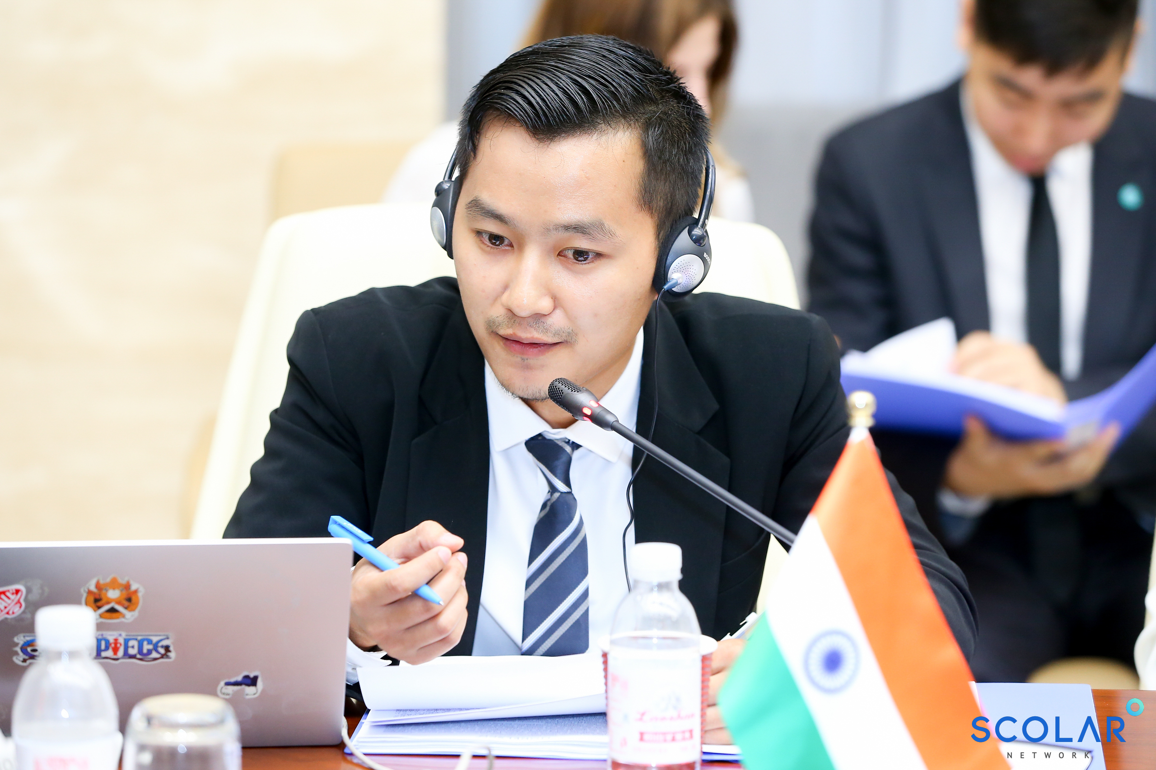
Delegations
Unlike other simulation conferences, in MSCO, the Secretary General does not play the role of moderator. Instead, the representatives of the Chair country perform these functions. Moderation can be provided in Russian, Chinese or English. Delegates from the chairing state divide the duties of moderation into two parts. One delegate is responsible for speeches and reading reports (opens the game, gives floor to other countries in accordance with the procedure, controls the time of speeches, closes the first part of the game). The second delegate is responsible for the discussion part (opens the discussion, gives the floor to other countries, coordinates the work of the Secretary General on the draft Declaration).
Chairmanship (moderator)
Like in official meetings of bodies and structures of the SCO, Model SCO is moderated by the Chair. The chairing country in the SCO is the host country of The Heads of State Council Summit. The order of the chairmanship of the countries is determined in accordance with the Russian alphabetical order of the names of the SCO member states.
Working language
The working languages of Model SCO are Russian, Chinese, and English. The working language is determined in advance by the Organizing Committee of Model SCO.

Slide 17
Regulations
The rule of order and seating
- The seating of the countries around the table complies with the SCO rules and procedures and is determined in accordance with the Russian alphabetical order of the names of states. Seating begins with the chairing country. Member States sit to the left of the Chair. To the right of the Chairman sits the Secretary General, and then the Director of the RATS. In the CHS and CHG, the Director of the RATS is followed by observer states also in the alphabetical order of the Russian language of state names.
- The same rule is applicable for the order of speeches and brief statements in discussion part.
The rule of personal privilege
- In case of any inconvenience, delegates may use the right of personal privilege. Delegates should contact the chairing side and explain the reason of their complaint. By decision of the chairing country, complaints may be granted or rejected.
- As part of the request for personal privileges, delegates cannot express their delegation’s position on the topic being discussed.
The rule of respect
Delegates should follow diplomatic etiquette and respect all staff and delegates. Delegates should be attentive to those who hold the floor and shall maintain decorum during all sessions. The Chairs should call to order immediately all delegates who fail to comply with this rule.

Slide 18
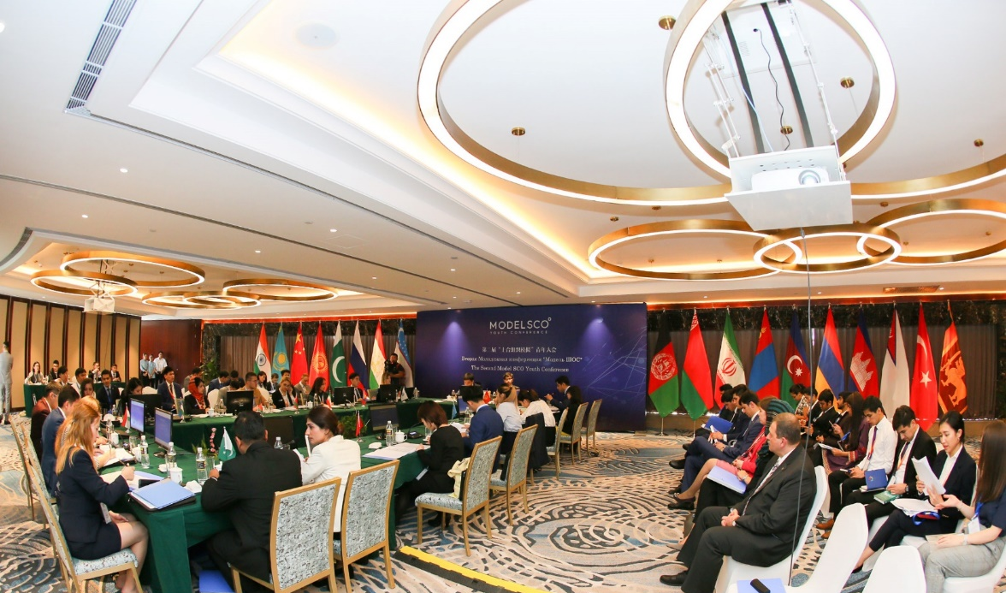
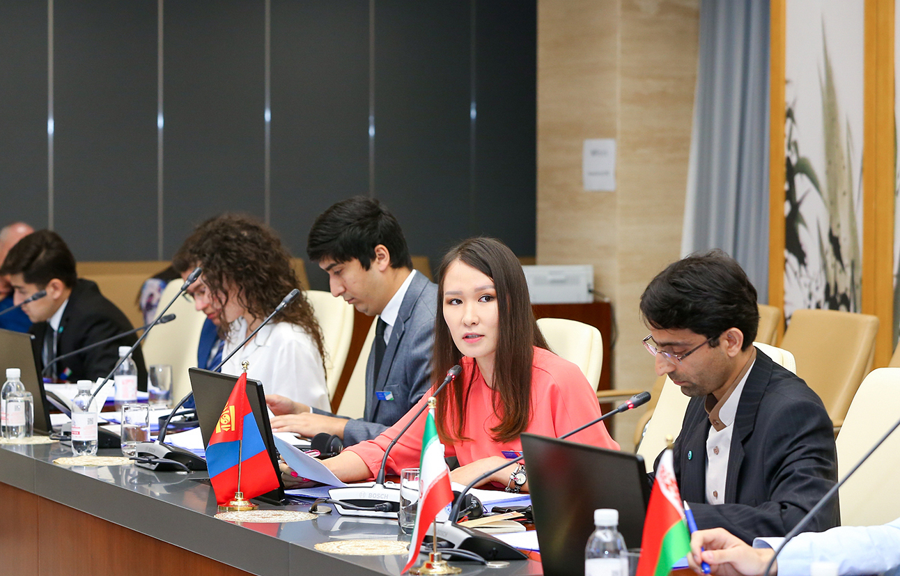
Regulations
The moderated discussion
- The moderated discussion is the main part of the discussion, during which delegates have the opportunity to modify the paragraphs of the draft of the Declaration based on the agreements reached.
- This part of the discussion is moderated by the Chair and only member states participate in the discussion. Discussion is conducted on each individual paragraph of the draft of the Declaration.
Free discussion
- Free discussion is initiated by the chairing country and is used only when disagreements arising during a moderated discussion are difficult or impossible to resolve within the framework of a moderated discussion. Both member states and observer states have the right to participate in free discussion. Chairs themselves determine the time frame for free discussion (the recommended time is 20 minutes). Delegates are free to move around in the conference room and lead discussions with other delegates. Exit from the conference room is prohibited. No more than two free discussions within the game are allowed.
- If during the last free discussion prior to the final poll, the parties initiate new versions of paragraphs, they must enlist the support of all delegations of member states and submit a new version of the paragraph to the Chair and the Secretary General before proceeding to the final poll.

Slide 19
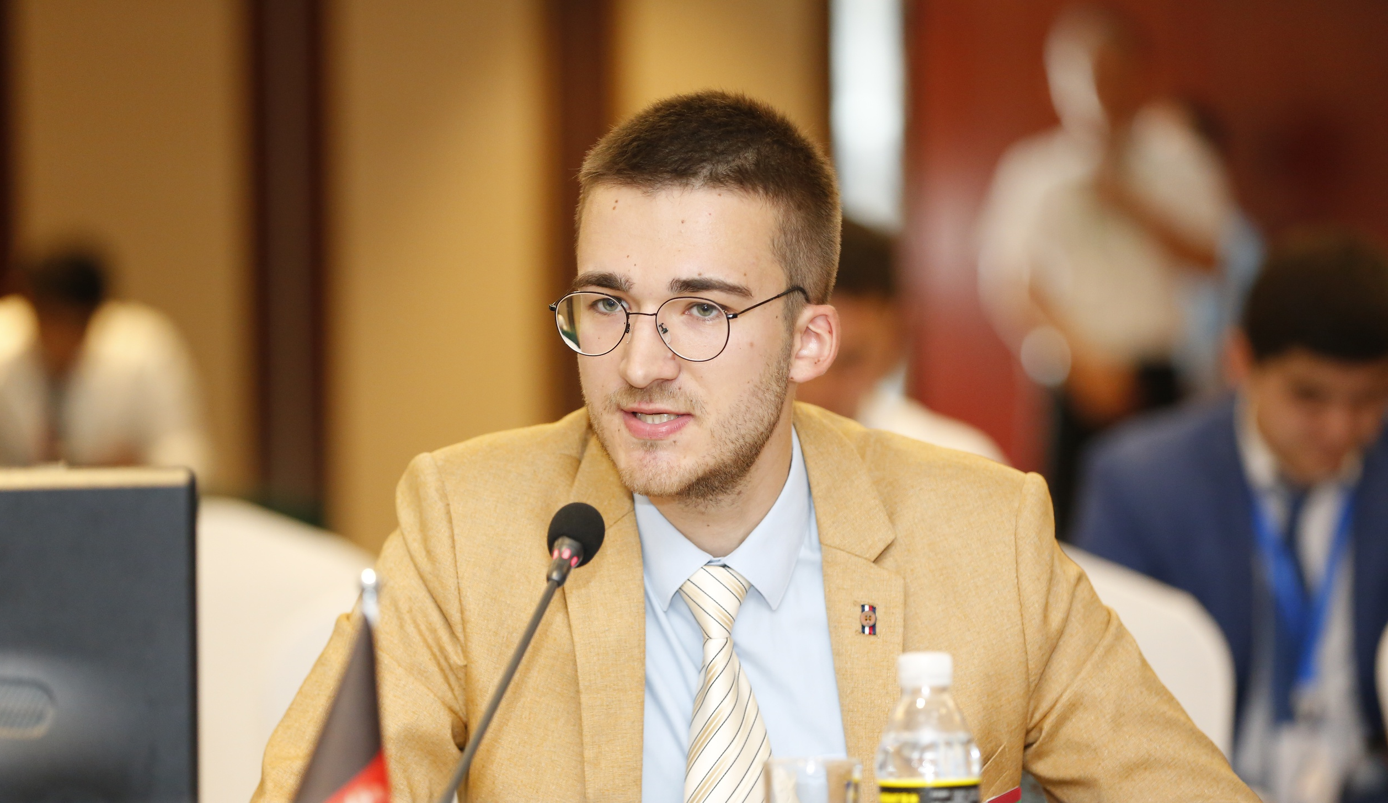
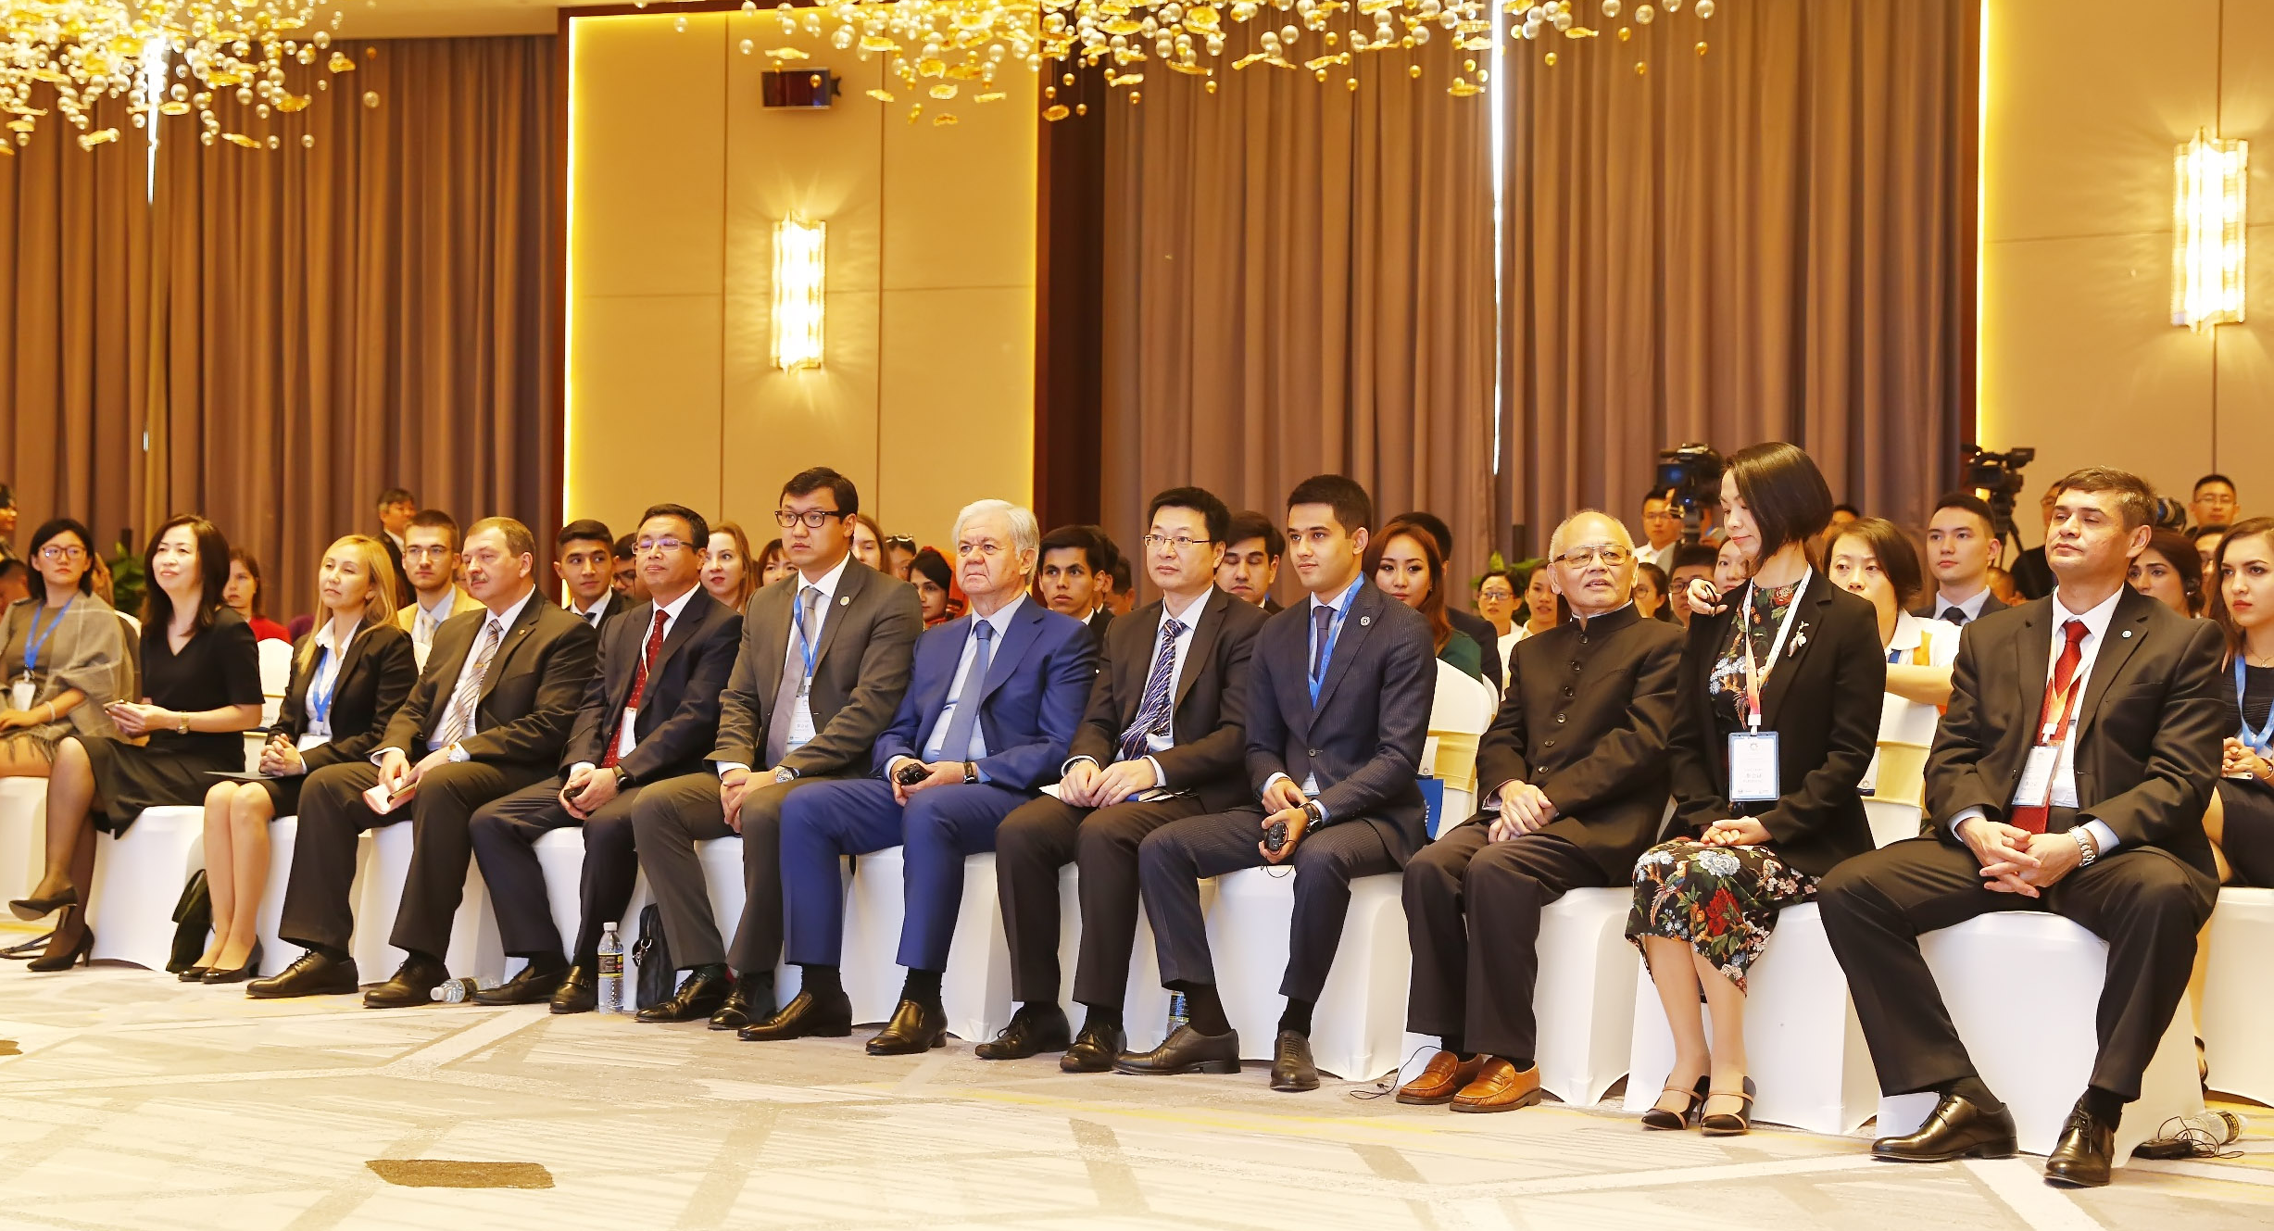
Regulations
The rule of consensus
- The consensus is the only decision-making principle. If all member states agree with the paragraph, Chairs keep it in the final version of the Declaration. If at least one member state country is against – the paragraph is excluded from the final document.
The point of rewriting
- If the member states do not agree with the formulation or the substance of the paragraph, they may request to the Chairs to introduce the point of rewriting of the paragraph. With the permission of the Chairs, the paragraph can be introduced by the requesting side. If all member states agree with the new formulation of the paragraph, it will be kept in the final version of the Declaration. If the consensus among the sides is not reached, the amendments will be excluded.

Slide 20
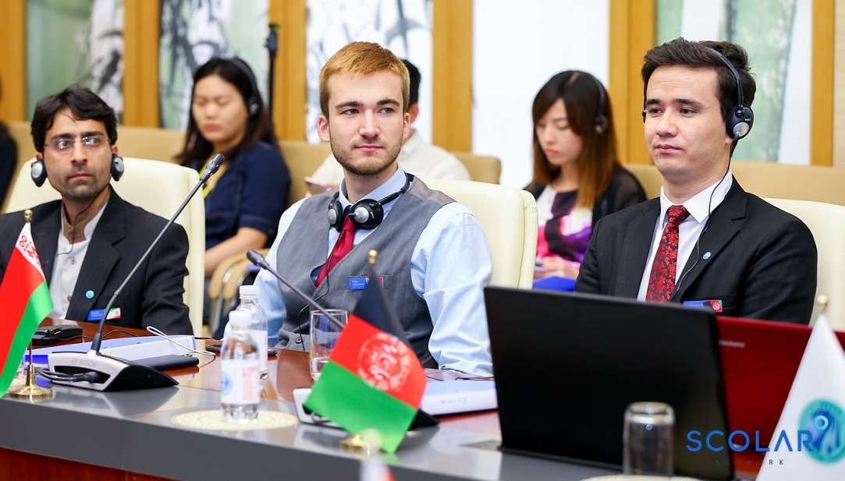
The main documents
Position Paper
Position Paper is a document with key points of represented country’s position on mentioned topic and possible solutions to existing problems.
Position Paper should be written from a represented country’s position, not delegate’s personal
Position Paper cannot be written in the singular first person (you can use “We”, but not “I”), the third person is recommended for writing (e.g. the name of represented country)
Languages: Russian, Chinese or English
Speaking Time: the time allowed for speeches is set by the Chair at his/her discretion. If a speaker pasts allowed time, the Chair may stop him/her. Speaking time begins as soon as the speaker begins his/her speech. Continuing to speak after the allowed time will not be tolerated.
Format of Position Paper
Two pages of A4 format
Times New Roman 12, MS Word format

Slide 21
The main documents
Structure of Position Paper
Introduction:
- Start with greetings of Chairs, Member and Observer States, Secretariat and RATS
- Make a statement on the position of represented country on a given topic
Body part 1
- Count existing or expecting problems, give some real examples
- Prepare statistics to prove your statement
Body part 2
- Give the detailed solutions to the problems (agencies responsible for it, timeline, financing e.g. subordinating, etc.)
- Count activities which a represented country uses to overcome these problems
Conclusion
- Summarize your statements

Slide 22
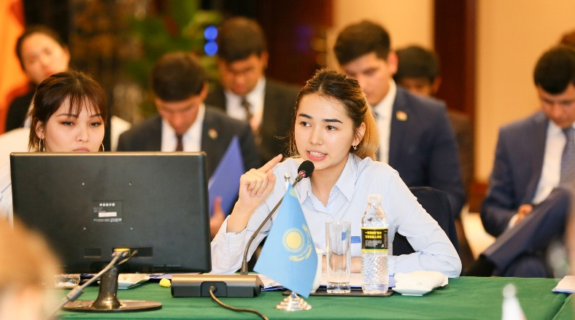
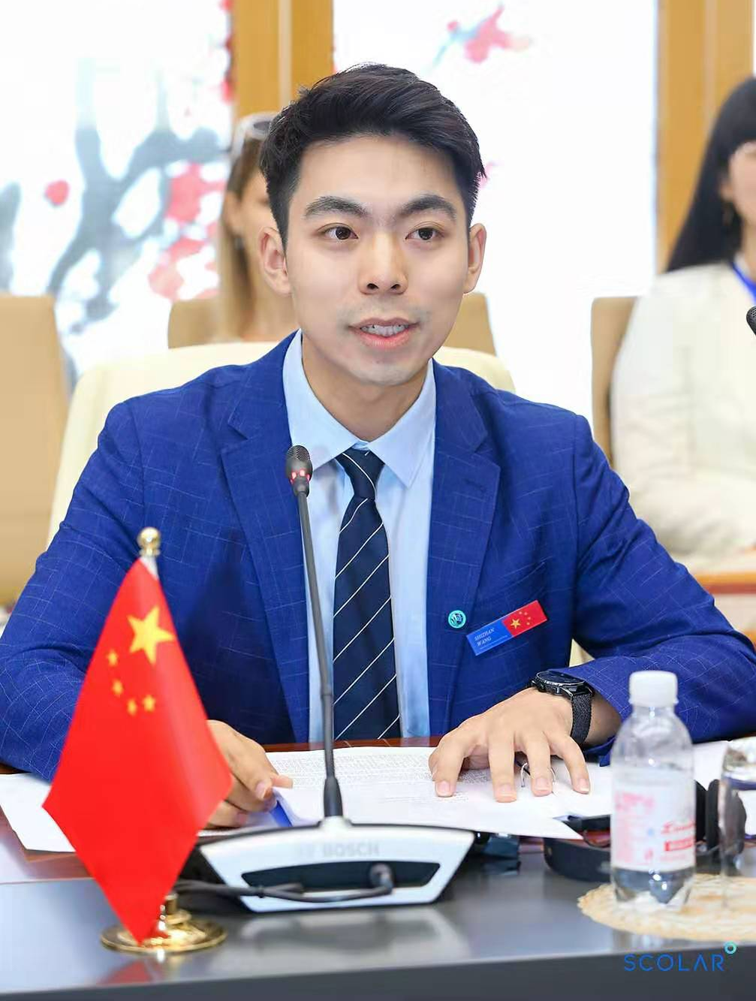
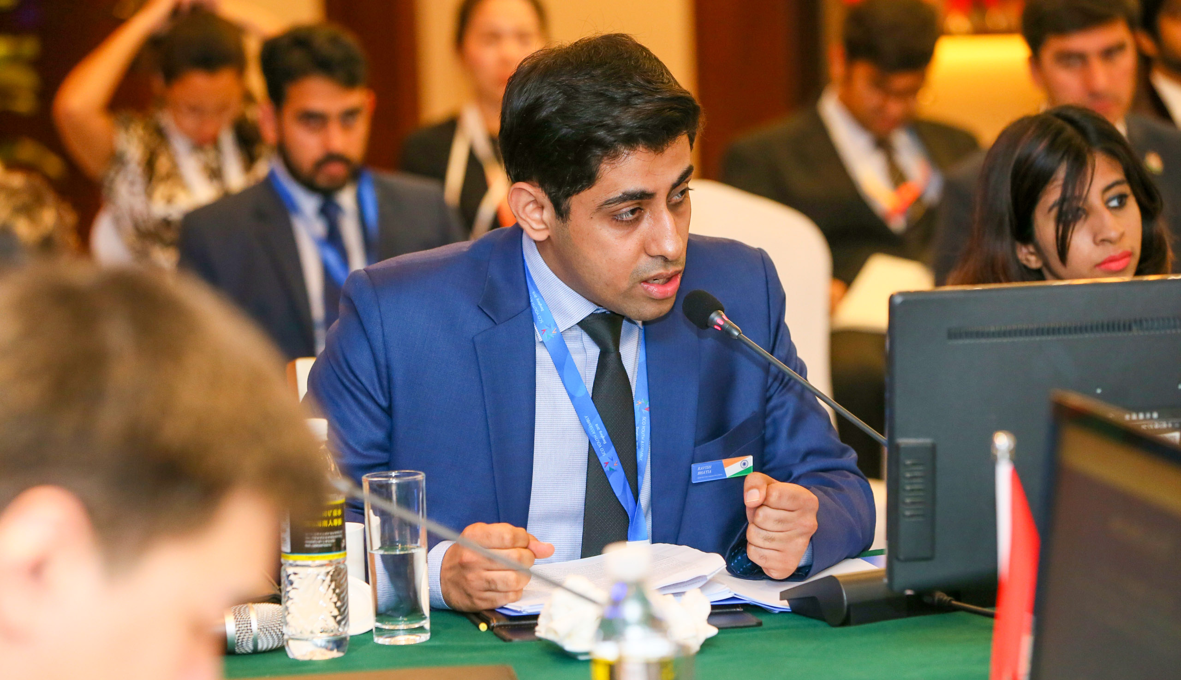
The main documents
Declaration
A brief document that contains positions of represented countries towards the given problems and their possible solutions.
All delegates must submit their Position Papers on time. Based on them Chair country and Secretary General will provide delegates with the draft of the Declaration with all mentioned topics and positions
The draft of the Declaration consists of several paragraphs according to the fields of activities (security, politics, economics, social life, cultural events, etc.). each paragraph combines the similar ideas of member states.
Decisions are made on the consensus basis.
After the approval of all member states, the Declaration will be signed by the Head delegates.

Slide 23
Feasibilty Proposal
Services from SCOLAR Network
plans selections of youth participants and training to delegates.
coordinate with each delegate to write position papers and draft a Declaration, and
promote the event before and after the main event.
Project Support from partners
Model SCO is conducted in collaboration with universities (Tsinghua and Nankai University) and support of SCO- Secretariat. Also, we collaborate with different SCO centers from SCO countries, such as the SCO Center of Friendship and Cooperation in Tajikistan, The Center for Public Diplomacy of SCO in Uzbekistan.
Our partners provide the needed logistics such as space for meetings, technical support, transportation facilities, food, and accommodation (if needed).
Media Support
Different media such as China plus, CGTN, Xinghua China feature MSCO.

Slide 24
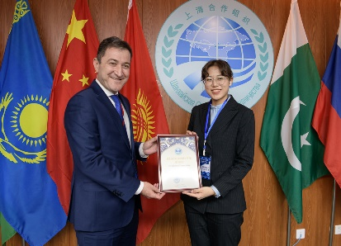
Results
13 conferences have been conducted with 239 delegates in 555 days of preparation and 70 hours of delegates negotiations.

Slide 25
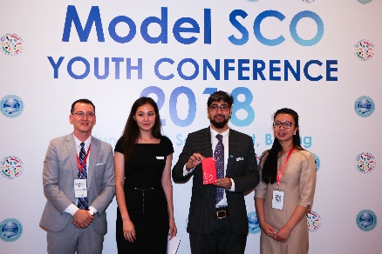
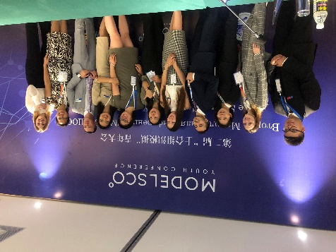
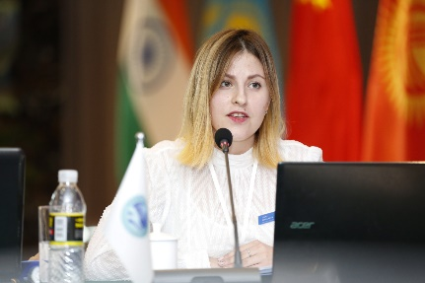
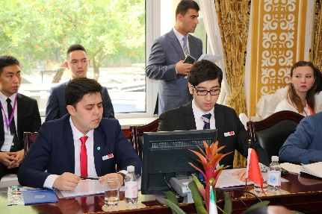
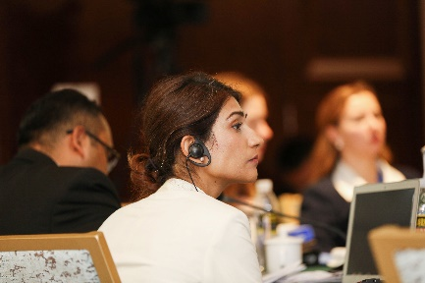
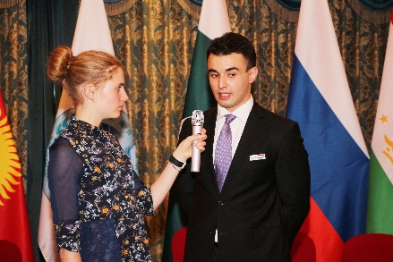
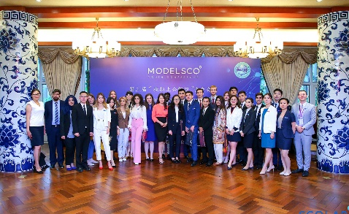
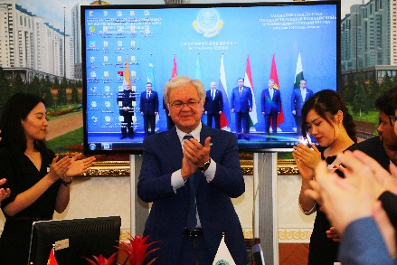
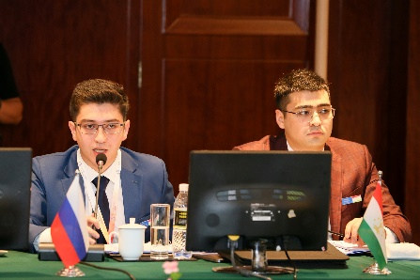
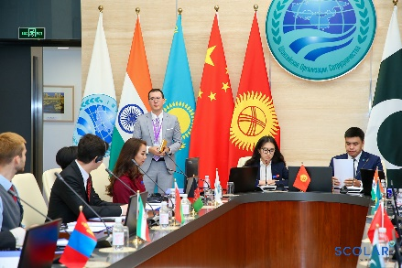
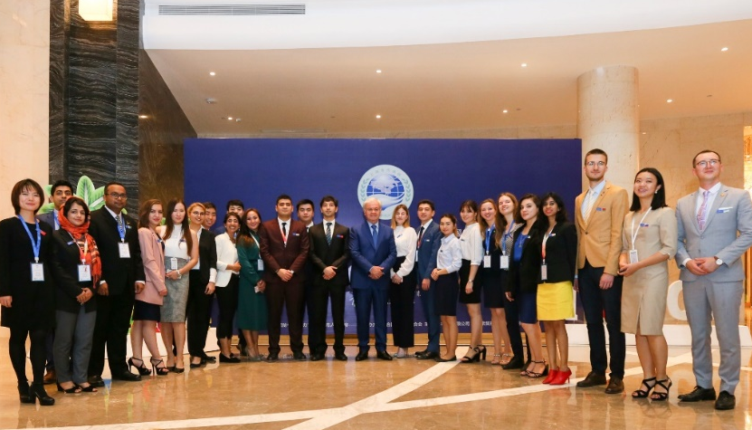
Our experience
II Model SCO, November 2018
I Model SCO, June 2018
III Model SCO, June 2019

Slide 26
Our experience
IV Model SCO, November 2019
Model SCO at Tsinghua University, November 2019

Slide 27
Our experience
V Model SCO, August 2020
VI Model SCO, December 2020

Slide 28
Our experience
II Model SCO at Tsinghua University,
December 2020
I Model SCO at Nankai University, May 2021
VII Model SCO, Dushanbe, May 2021

Slide 29
Our experience
VIII Model SCO, Tashkent, Nov. 2021
IX Model SCO, Guliston, March 2022
II Nankai University Model SCO, May 2022

Slide 30
Future Development
Conduct MSCO at chair country of the SCO - at least once a year.
Run MSCO within 9 hubs in 6 different countries.
Planning to bring MSCO to corporates.
bring trainings to future diplomats and young professionals/students who want to work in the international organizations

Slide 32
Follow SCOLAR
on WeChat
Read more about
Model SCO
Read more about
the SCO countries
admin@scolar.life
scolarnetwork

