Slide 2
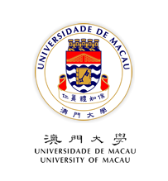
Style and Status in the Retranslations of The Art of War LUO Tian(罗天) English Department, FAH, University of Macau SFL, Chongqing Jiaotong University kkkluo@foxmail.com
Xi’an, June. 17-18, 2016

Slide 4
Outline
1. Introduction
2. Stylistic analysis and Polysystem Theory
3. Data and Methodology
4. Stylistic differences in the target texts
5. Different status, different styles
6. Conclusion

Slide 5
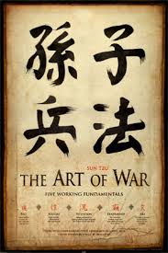
1. Introduction
The Art of War, a key cultural text of strategy, written about 5th century BC by Sun Tzu
translated into almost every major language
about 58 English versions from 1905 to 2012
stylistic difference among these retranslations remains under-investigated

Slide 6
2. Stylistic analysis and Polysystem Theory
2.1 Stylistic analysis
A. definition of style : “any situationally distinctive use of language, and of the choices made by individuals and social groups in their use of language” (Crystal 1999:323).
B. Enkvist (1964: 29) proposes a comparative mode for the analysis of style: “to measure the style of a passage, the frequencies of its linguistic items of different levels must be compared with the corresponding features in another text or corpus”

Slide 7
C. checklist of stylistic categories
a. lexical categories
b. grammatical categories
d. figures of speech
d. cohesion and context (Leech and Short 1981: 75-81)

Slide 8
C. style in translation studies
a. Equivalence in style
Tytler (1907 /2007: 9) holds that for a good translation, “the style and manner should be of the same character with that of the original”
Nida and Taber (1969: 12): “Translating consists in reproducing in the receptor language the closest natural equivalent of the source-language message, first in terms of meaning and secondly in terms of style”.

Slide 9
b.corpus-based approach to style:
“translator’s style”: Baker (2000)
c. constraints on translator’s style:
the relations between style and ideology (Munday 2008)

Slide 10
2.2 Polysystem theory
A. Even-Zohar (1990: 11)
translated literature is viewed as a system operating in the larger social, literary and historical systems of the target culture, in which there is an ongoing dynamic of “mutation” struggle for the primary position in the literary canon

Slide 11
B. secondary position taken by translated literature
“normal” status
peripheral system

Slide 12
C. Primary position taken by translated literature
a. ready-made model for a “young” literature
b. literary type imported for the “peripheral” or “weak”
c. critical turning point where established models are not considered sufficient

Slide 13
D. Status and style
Even-Zohar (2000:203-204) suggests that the position occupied by translated literature in the polysystem conditions the translation strategy.
Secondary position more acceptable
Primary position more adequacy-oriented
Position Translator’s choice over style ?

Slide 14
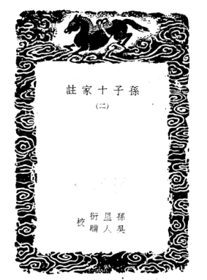
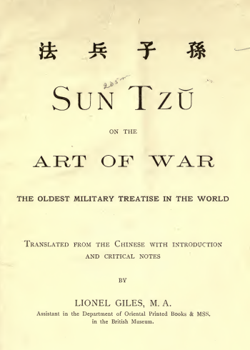
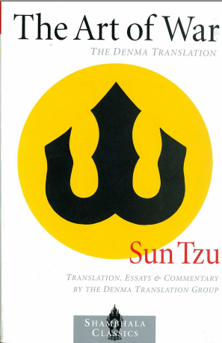
3. Data and methodology
3.1 Data source and processing
ST: Sun Xinyan’s edition of Sun Tzu’s The Art of War: 6,267 words
TT1: Lionel Giles’ translation in 1910: 10,635 words
TT2: The Art of War: The Denma Translation in 2001: 8,005 words

Slide 15
3.2 Analytical framework
A. At lexical level
type-token ratio: lexical variation or diversity
B. At the sentence level
average sentence length syntactic complexity
C. At rhetorical level
parallelism: rhetorical devices

Slide 16
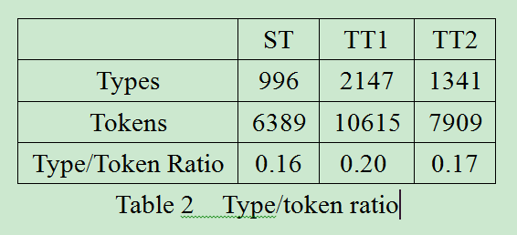
4. Stylistic differences in the target texts
4.1 Style at lexical level

Slide 17
Example 1
ST: 圮地无舍，衢地交和，绝地勿留，围地则谋，死地则战。
TT1: When in difficult country, do not encamp. In country where high roads intersect, join hands with your allies. Do not linger in dangerously isolated positions. In hemmed-in situations, you must resort to stratagem. In a desperate position, you must fight.
TT2: In spread-out ground do not encamp. In junction ground join with allies. In crossing ground do not linger. In enclosed ground strategize. In death ground do battle.

Slide 18
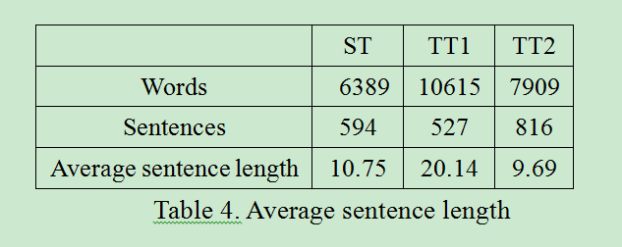
4.2 Style at sentence level

Slide 19
Example 2
ST:将听吾计，用之必胜，留之﹔将不听吾计，用之必败，去之。
将听吾计，( )用之（将）必胜， ( )留之﹔将不听吾计， ( )用之（将）必败， ( )去之。
TT1: The generals that hearkens to my counsel and acts upon it, will conquer; let such a one be retained in command! The general that hearkens not to my counsel nor acts upon it, will suffer defeat: let such a one be dismissed. (42 words)
TT2: The general heeds my appraisals. Employ him and he is certainly victorious. Retain him. The general does not heed my appraisals. Employ him and he is certainly defeated. Remove him. (26 words)

Slide 20
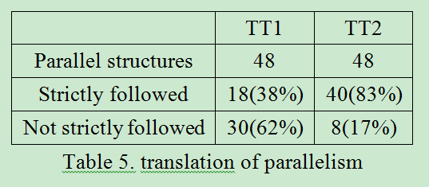
4.3 Style at rhetorical level

Slide 21
Example 3
ST: 非圣智不能用间。非仁义不能使间。非微妙不能得间之实。
TT1: Spies cannot be usefully employed without a certain intuitive sagacity. They cannot be properly managed without benevolence and straightforwardness. Without subtle ingenuity of mind, one cannot make certain of the truth of their reports.
TT2: If not a sage, one cannot employ spies. If not humane, one cannot send out spies. If not subtle and secret, one cannot obtain a spy's treasure.

Slide 22
4.4 Summary
Great difference in style between TT2 and TT2
TT1: more target-oriented
TT2: more source-oriented

Slide 23
5. Different status, different styles
5.1 Secondary position to be taken by TT1:
A. Calthrop’s first English translation(1905)， a failure
B. western military theory monopolized by the book On War by von Clausewitz
C. seldom referred to in western strategic(military) texts

Slide 24
5.2 Primary position to be enjoyed by TT2
(90 years past…)
A. Followers: Liddel Hart, Richard Nixon, John Boyd
B. Clausewitz’s On War criticized
C. Sun Tzu frequently quoted in western military texts
D. Extensively taught in American Professional military universities and included in reading list
E. In the 21st century, “Western strategic thought more attuned to Sun Tzu’s thought as well as Chinese strategic thought as a whole” (Yuen, 2014:127)

Slide 25
5.3 A conscious choice by translators?
Giles: “the Chinese of this sentence is so concise as to be practically unintelligible without commentary”
Denma Translation Group:“Our translation seeks to make the Sun Tzu as immediate and evocative for the English-speaking readers as it was for its Chinese lineage holders.”

Slide 26
6. Conclusion
Great difference in style exists between the translation by Giles and the one by Denma Translation Group:
Giles’: non-status of the art of war in the western strategic cultural system target-oriented style
Denma’s: secured primary position of Sun Tzu in western strategic cultural system source-oriented style
translator’s different choice over style may be conditioned by the status that the translated text takes (or is to take) in the target cultural system.

Slide 27
References
Bosseaux, C. (2004). Point of view in translation: A corpus-based study of French translations of Virginia Woolf’s To the Lighthouse. Across Languages and Cultures, 5(1), 107-123.
Calthrop, E. F.(trans.).(1905). Sonshi: The Chinese Military Classic. Tokyo: Sanseido.
Carter, R. (ed.). (1982). Language and literature: An introductory reader in stylistics, London: Allen and Unwin.
Crystal, D. (1999). The Penguin dictionary of language. London: Penguin Books.
Enkvist, N. E. (1964). On defining style: An essay in applied linguistics. In Spencer, J. (ed.) Linguistics and style(pp.3-56). London: Oxford University Press.
Even-Zohar, I. (1990). Polysystem Studies, Poetics Today, 11(1), 1-252.
Even-Zohar, I. (2000). The position of translated literature within the literary polysystem. In Venuti, L.(ed.) (2000) The Translation Studies Reader (pp.194-197). London and New York: Routledge..
Gideon, T. (1995). Descriptive translation studies and beyond. Amsterdam & Philadelphia: John Benjamins.
Giles, L.(trans). (1910). The Art of War: The Oldest Military Treatise in the World. London: Luzac & Co.
Hart, L. (1963). Foreword. In: Griffith, S. B. (trans). Sun Tzu: The Art of War. Oxford University Press.
Leech, G., & Short, M. (1981). Style in fiction: A linguistic introduction to English fictional prose. London: Longman.
Liu, Z, & Liu C, & Zhu, H. (2011). An exploration of the translators’ styles of four English versions of Hong Lou Meng. Chinese Translators Journal, 32(1), 60–64. [刘泽权、刘超朋、朱虹. (2011).《红楼梦》四个英译本的译者风格初探——基于语料库的统计与分析. 中国翻译, 32(1), 60–64. ]
Lord, C. (2000). A Note on Sun Tzu. Comparative Strategy,19( 4),301-307.
Luo, T. & Zhang, M. (2015). Research of translations of The Art of War: past and prospects. Translation Quarterly, 75, 50-65.

Slide 28
Marshall, A. S.(1999). Flying officer, Is Sun Tzu's “Art of War” relevant to the modern air force? RUSI Journal, 144(5), 57-59.
Minford, J. (2008). Forward. In Minford, J.(Trans.) Sun Tzu: The Art of War(pp. vii-xxv). Tokyo, Rutland, Vermont, Singapore: Tuttle Publishing.
Munday, J. (2008).Style and ideology in translation: Latin American writing in English. New York and Oxon: Routledge.
Nida, E. A., & Taber, C. (1969). The theory and practice of translation. Leiden: Brill.
O’Dowd, E. & Waldron. A. (1991). Sun Tzu for Strategists. Comparative Strategy, 10(1): 25-36.
Olohan, M. (2004). Introducing corpora in translation studies. London: Routledge.
Phua, C. R. (2007). From The Gulf War to Global War on Terror: A distorted Sun Tzu in US strategic thinking. RUSI Journal, 152(6),46-52.
Saldanha, G. (2011a). Style of translation: The use of foreign words in translations by Margaret Jull Costa and Peter Bush. In Kruger A., & Wallmarch, K. & Munday, J.(Eds.) Corpus-based translation studies: Research and applications (pp. 20–35). London: Continuum.
Saldanha, G. (2011b). Translator style: Methodological considerations. The Translator, 17(1): 25–50.
Song, Z. W. (2012). The Art of War in retranslating Sun Tzu: Using cultural capital to outmatch the competition. Translation and Interpreting Studies, 7(2),176-190.
Su, G.L.(2011). Study on the English versions of The Art of War. Journal of Binzhou University, 27(5),149-156. [苏桂亮. (2011).《孙子兵法》英文译著版本考察. 滨州学院学报,27(5), 149-156.]
The Denma Translation Group. (2002). About the Translation. In The Denma Translation Group (Trans.) The Art of War(pp.225-229). Boston: Shambhala Publications.
Tytler, A. F. (1907/2007). Essays on principles of translation. Beijing: Foreign Language Teaching and Research Press.
Wales, K. (2001). A dictionary of stylistics. London: Longman.
Williams, T. (2003). Strategic Leader Readiness and Competencies for Asymmetric Warfare. Parameters, 33(2),19-35.
Winters, M. (2007). F. Scott Fitzgerald’s Die Schönen und Verdammten: A corpus-based study of speech-act report verbs as a feature of translators’ style. Meta, 52(3), 412–425.
Winters, M. (2009). Modal particles explained: How modal particles creep into translations and reveal Translators’ styles. Target, 21(1), 74–97.
Yuen, D. M. C. (2014). Deciphering Sun Tzu: How to read The Art of War. New York: Oxford University Press.
Zhang, G. J. (2013). Theory of Misreading: Evolution in the retranslation of literary classics. Foreign Language Education, (3), 105-108 [章国军. (2013).名著复译“误读进化论”——以《孙子兵法》复译为例[J]. 外语教学, (3),105-108.]

Slide 29
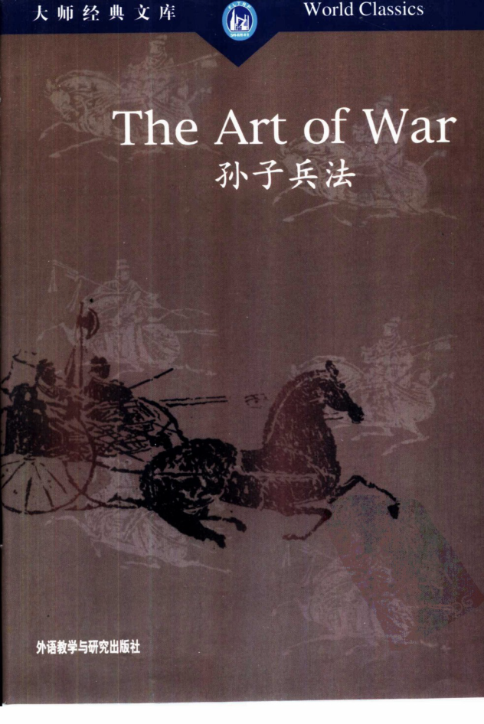
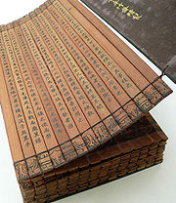
Thank you！

